Slide 1




Slide 2
Objectives
Explain the purpose and objectives of object-oriented design
Develop design class diagrams
Develop interaction diagrams based on the principles of object responsibility and use case controllers
Object-Oriented Analysis and Design and the Unified Process

Slide 3
Objectives (continued)
Develop detailed sequence diagrams as the core process in systems design
Develop communication diagrams as part of systems design
Document the architecture design using package diagrams
Object-Oriented Analysis and Design and the Unified Process

Slide 4
Overview
Develop detailed object-oriented design models
Develop models for each layer of a three-layer design
Design class diagrams
  Extend domain model
Interaction diagrams
  Extend system sequence diagrams
Package diagrams
  Show relationships and dependencies among classes
Object-Oriented Analysis and Design and the Unified Process

Slide 5
What is Object-Oriented Design?
The bridge between a user’s requirements and programming for the new system
  “Blueprints”, or design models, are necessary to build systems
An adaptive approach to development
  Requirements and design are done incrementally within an iteration
  A complete set of designs may not be developed at one time
Object-Oriented Analysis and Design and the Unified Process

Slide 6
Overview of Object-Oriented Programs
Object-oriented programs consist of a set of computing objects that cooperate to accomplish a result
  Each object has program logic and data encapsulated within it
  Objects send each other messages to collaborate
Most object-oriented programs are event-driven
Instantiation of a class creates an object based on the template provided by the class definition
Object-Oriented Analysis and Design and the Unified Process

Slide 7
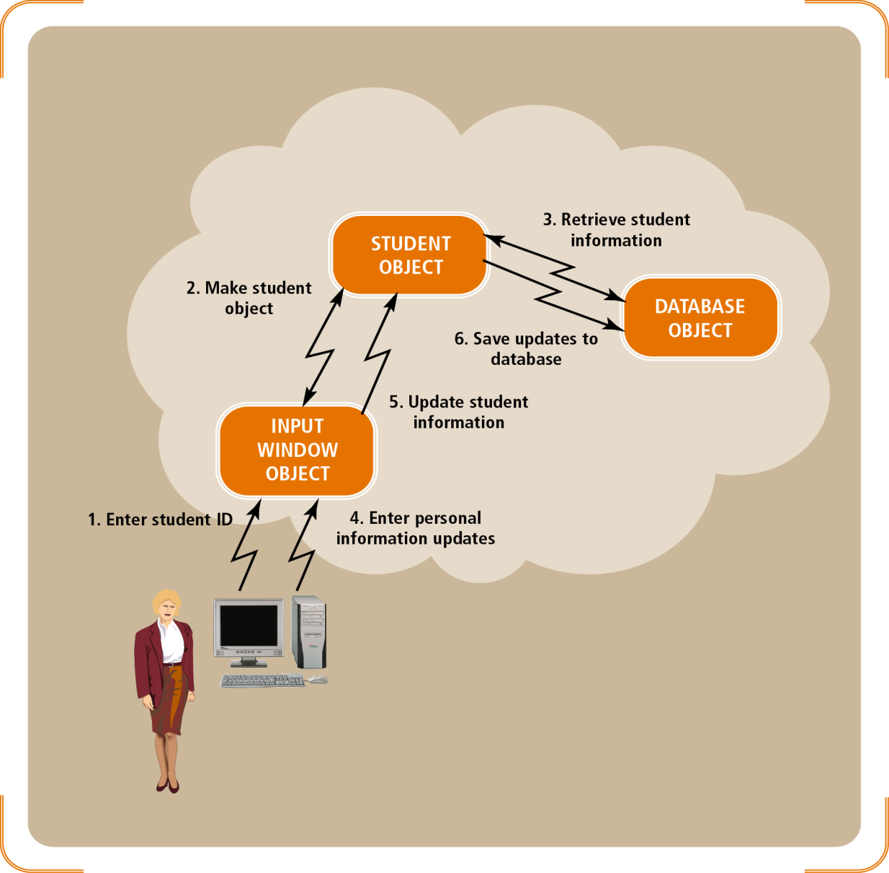
Figure 8-1
Object-oriented event-driven program flow
Object-Oriented Analysis and Design and the Unified Process

Slide 8
Object-Oriented Design Models
Identify all objects that must work together to carry out a use case
Divide objects into groups for a multilayer design
Interaction diagrams describe the messages that are sent between objects
  Includes sequence and communication diagrams
Design class diagrams document and describe the programming classes
Object-Oriented Analysis and Design and the Unified Process

Slide 9
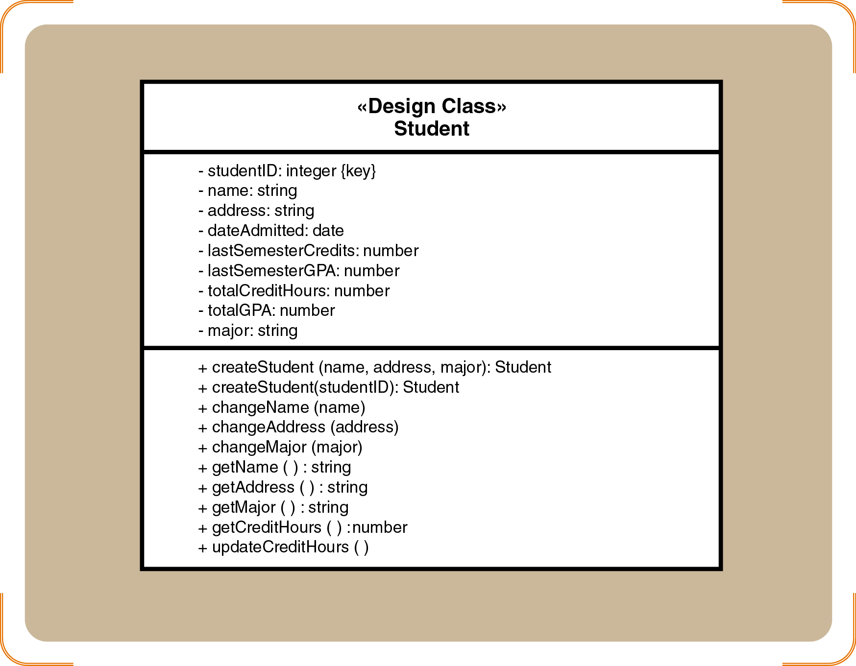
Figure 8-2
Design class for Student class
Object-Oriented Analysis and Design and the Unified Process

Slide 10
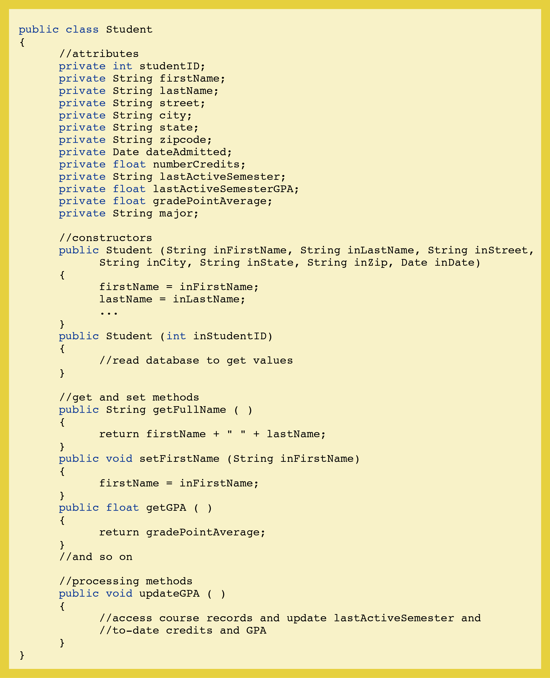
Figure 8-3
Class definition of the Student class in the Java programming language
Object-Oriented Analysis and Design and the Unified Process

Slide 11
Object-Oriented Design Models (continued)
State charts capture information about the valid states and transitions of an object
Package diagrams denote which classes work together as a subsystem
Design information is primarily derived from
  Domain model class diagrams
  Interaction diagrams
Object-Oriented Analysis and Design and the Unified Process

Slide 12
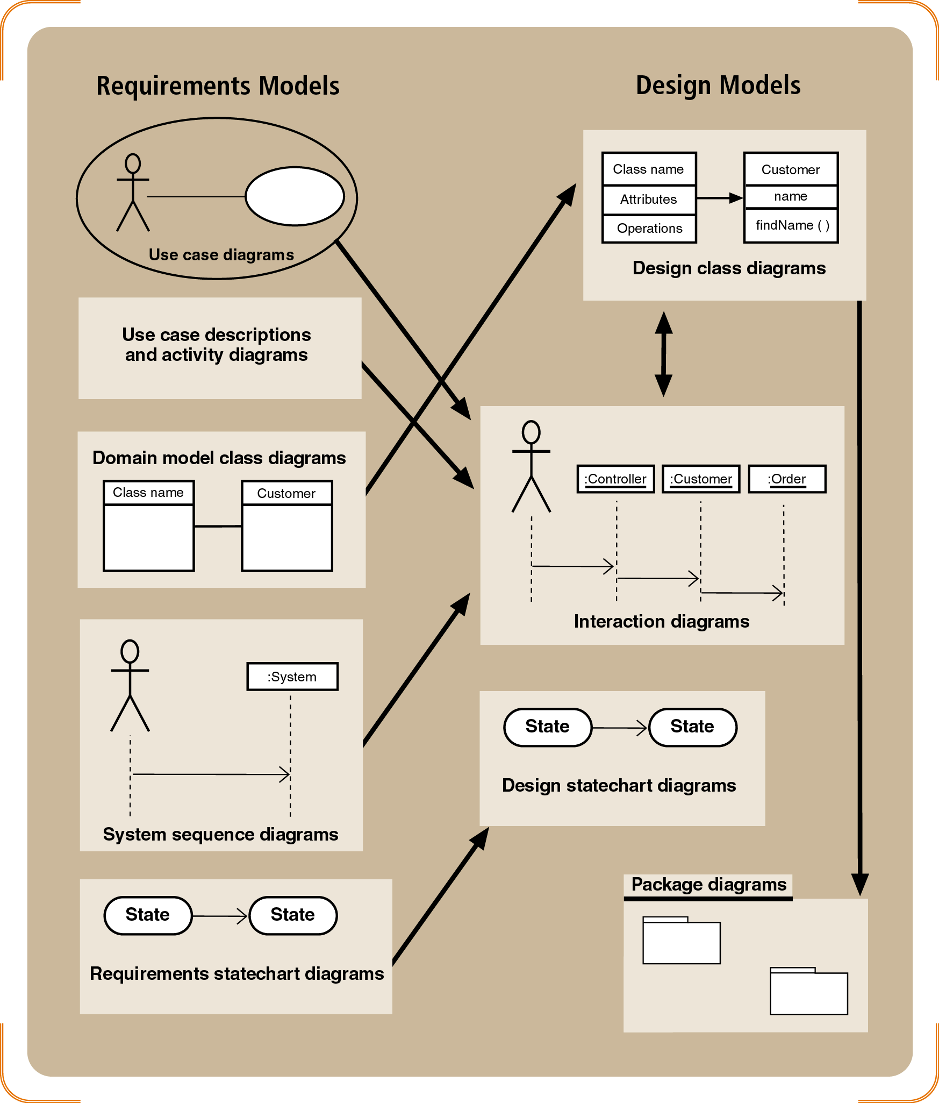
Figure 8-4
Design models with their respective input models
Object-Oriented Analysis and Design and the Unified Process

Slide 13
Object-Oriented Design Process
Create a first-cut model of the design class diagrams
Develop interaction diagrams for each use case or scenario
Update the design class diagrams
  Method names, attributes, and navigation visibility
Partition the design class diagrams into related functions using package diagrams
Object-Oriented Analysis and Design and the Unified Process

Slide 14
Design Classes and Design Class Diagrams
Design class diagrams are extensions of domain class model diagrams
  Elaborate on attribute details
  Define parameters and return values of methods
  Define the internal logic of methods
A first-cut design class diagram is based on the domain model and engineering design principles
Interaction diagrams (Collaboration and Sequence Diagrams) are used to refine a design class diagram as development progresses
Object-Oriented Analysis and Design and the Unified Process

Slide 15
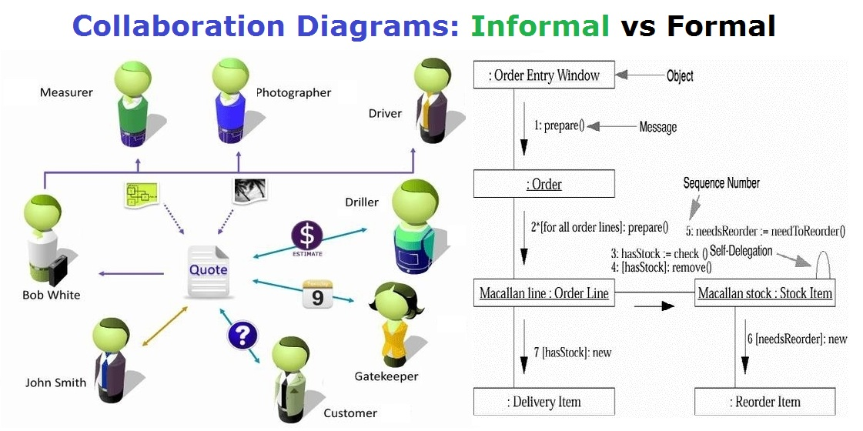
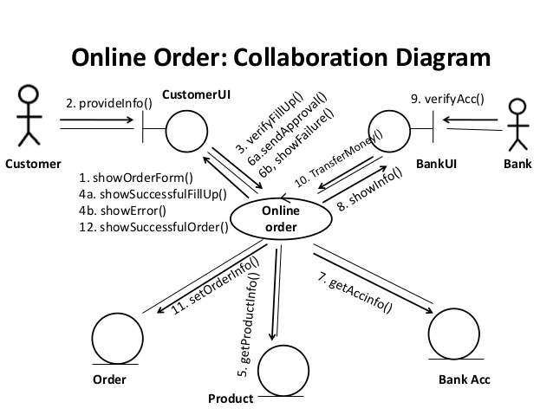
Object-Oriented Analysis and Design and the Unified Process

Slide 16
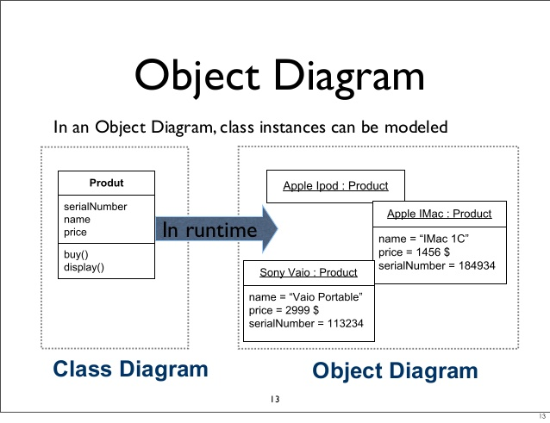
Object-Oriented Analysis and Design and the Unified Process

Slide 17
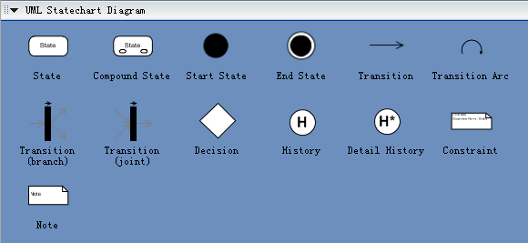
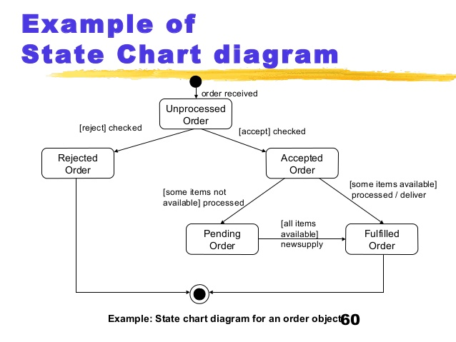
Object-Oriented Analysis and Design and the Unified Process

Slide 18
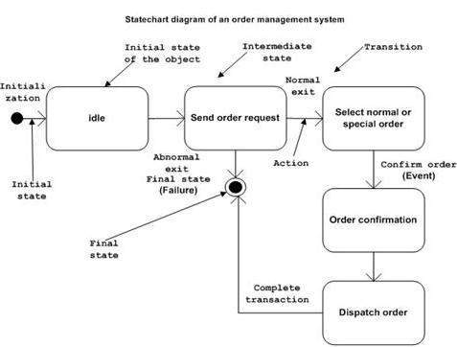
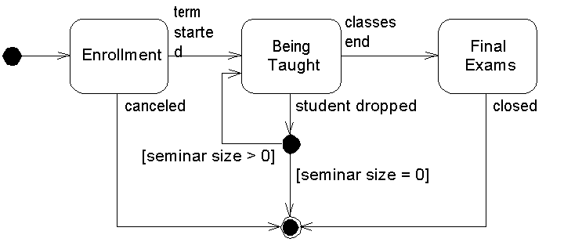
Object-Oriented Analysis and Design and the Unified Process

Slide 19
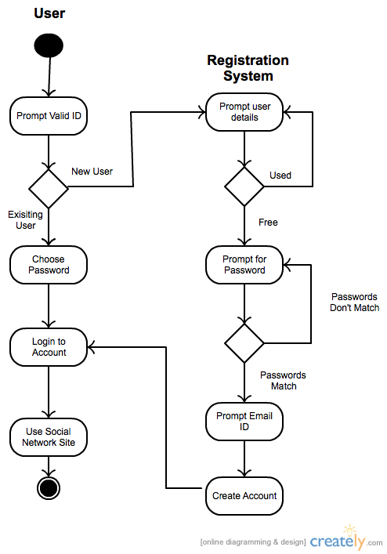
Object-Oriented Analysis and Design and the Unified Process

Slide 20
Design Class Symbols
Stereotypes
  UML notation to categorize a model element as a certain type
Two types of notation
  Full notation with guillemets («»)
  Shorthand notation with circular icons
Standard stereotypes
  Entity, control, boundary, data access
Object-Oriented Analysis and Design and the Unified Process

Slide 21
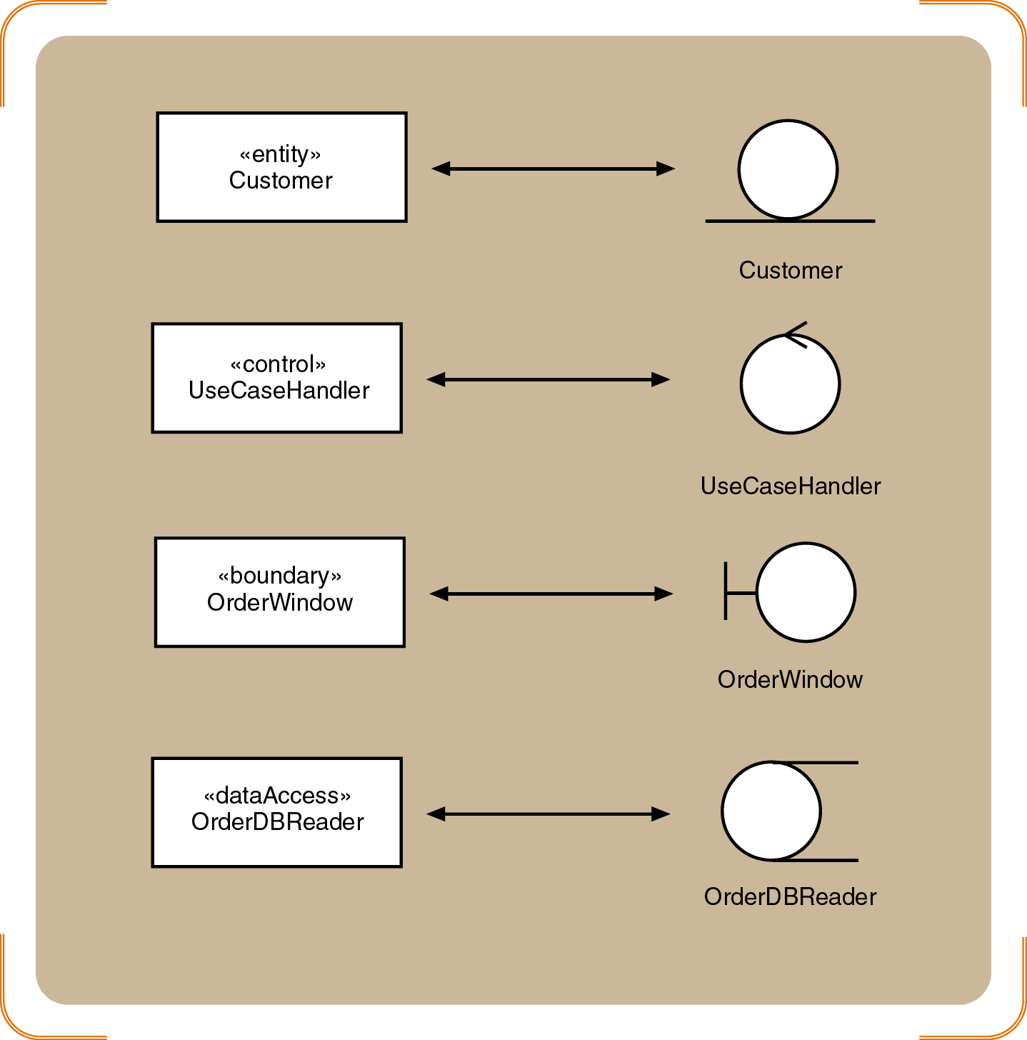
Figure 8-5
Standard stereotypes found in design models
Object-Oriented Analysis and Design and the Unified Process

Slide 22
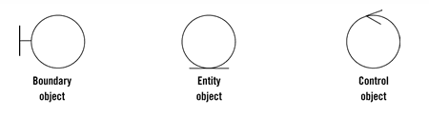
Entities (model)
Objects representing system data, often from the domain model.
Boundaries (view/service collaborator)
Objects that interface with system actors (e.g. a user or external service). Windows, screens and menus are examples of boundaries that interface with users.
Controls (controller)
Objects that mediate between boundaries and entities. These serve as the glue between boundary elements and entity elements, implementing the logic required to manage the various elements and their interactions. It is important to understand that you may decide to implement controllers within your design as something other than objects – many controllers are simple enough to be implemented as a method of an entity or boundary class for example.
Four rules apply to their communication:
Actors can only talk to boundary objects.
Boundary objects can only talk to controllers and actors.
Entity objects can only talk to controllers.
Controllers can talk to boundary objects and entity objects, and to other controllers, but not to actors
Robustness diagrams are written after use cases and before class diagrams. They help to identify the roles of use case steps. You can use them to ensure your use cases are sufficiently robust to represent usage requirements for the system you're building.
They involve:
Actors
Use Cases
Entities
Boundaries
Controls
Entity-Control-Boundary Pattern (ECB) is used for systems.
Entities (model)
Objects representing system data, often from the domain model.
Boundaries (view/service collaborator)
Objects that interface with system actors (e.g. a user or external service). Windows, screens and menus are examples of boundaries that interface with users.
Controls (controller)
Objects that mediate between boundaries and entities. These serve as the glue between boundary elements and entity elements, implementing the logic required to manage the various elements and their interactions. It is important to understand that you may decide to implement controllers within your design as something other than objects – many controllers are simple enough to be implemented as a method of an entity or boundary class.
Four rules apply to their communication:
Actors can only talk to boundary objects.
Boundary objects can only talk to controllers and actors.
Entity objects can only talk to controllers.
Controllers can talk to boundary objects and entity objects, and to other controllers, but not to actors
Object-Oriented Analysis and Design and the Unified Process

Slide 23
Design Class Notation
Class name and stereotype information
Attribute information
  Visibility, type-expression, name, initial value, and properties
Method signature
  Visibility, name, type-expression, and parameter list
  Use the entire signature to identify a method to distinguish between overloaded methods
Object-Oriented Analysis and Design and the Unified Process

Slide 24
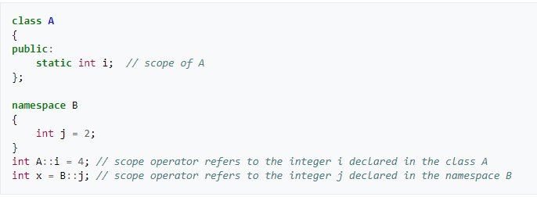
Object-Oriented Analysis and Design and the Unified Process

Slide 25
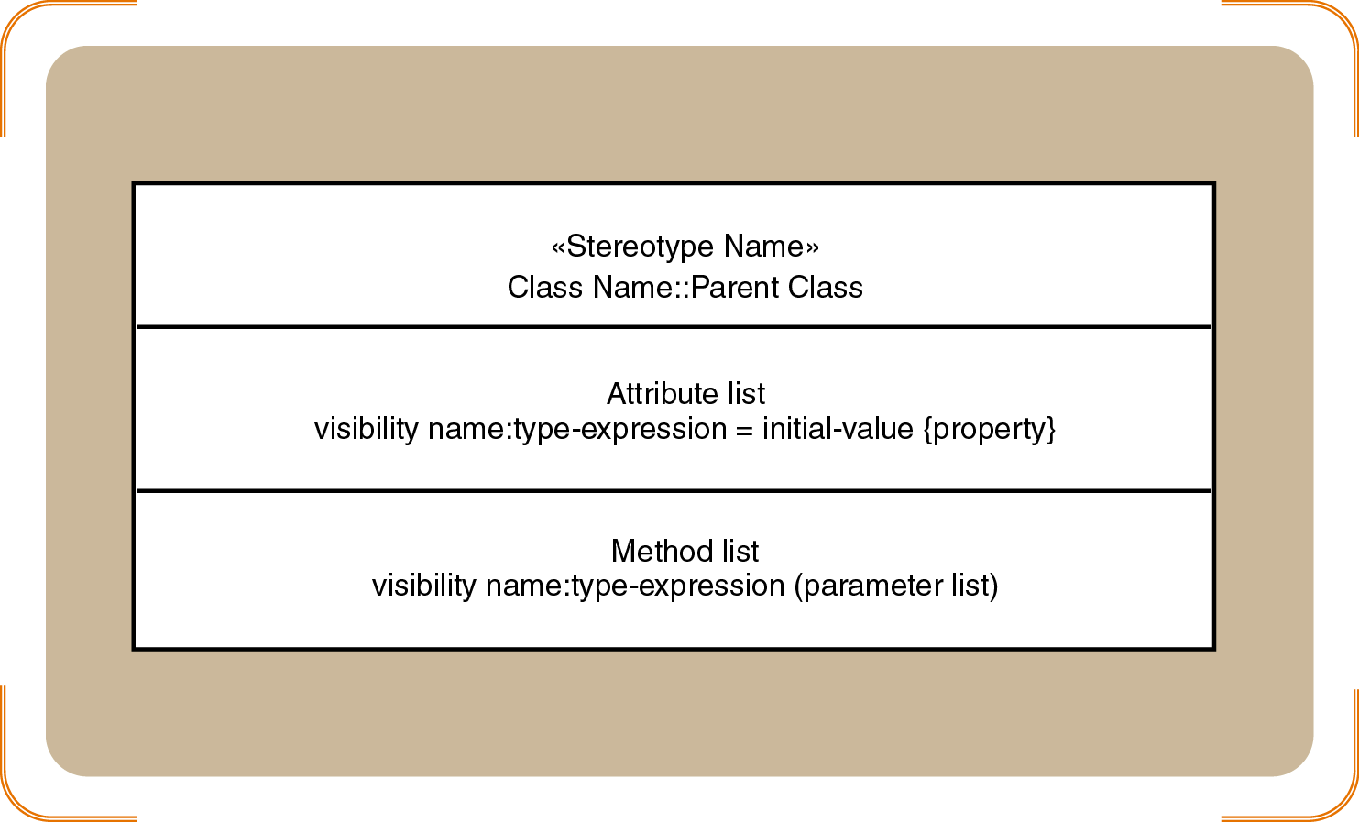
Figure 8-6
Internal symbols used to define a design class
Object-Oriented Analysis and Design and the Unified Process

Slide 26
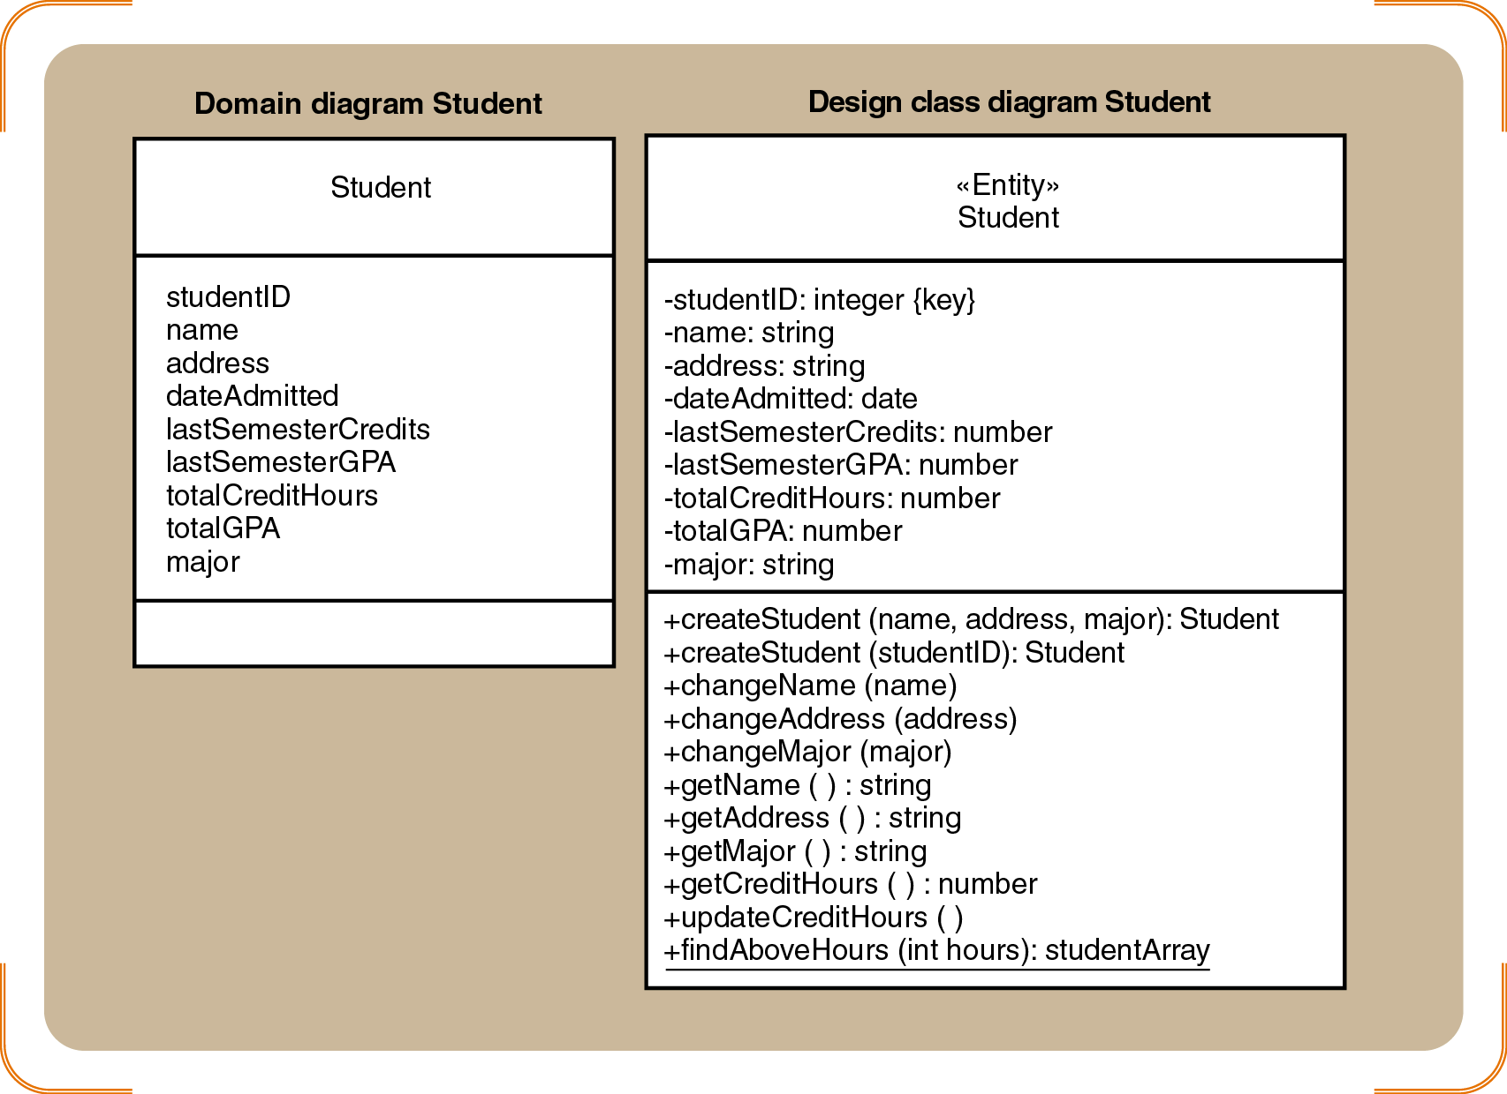
Figure 8-7
Student class examples for the domain diagram and the design class diagram
Object-Oriented Analysis and Design and the Unified Process

Slide 27
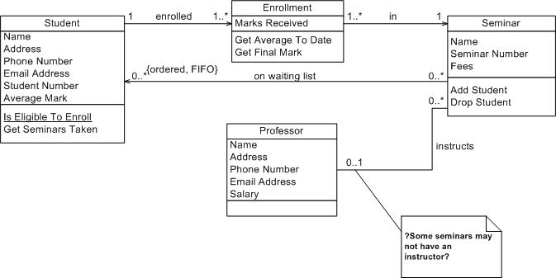
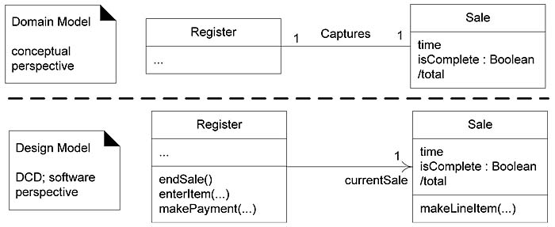
Object-Oriented Analysis and Design and the Unified Process

Slide 28
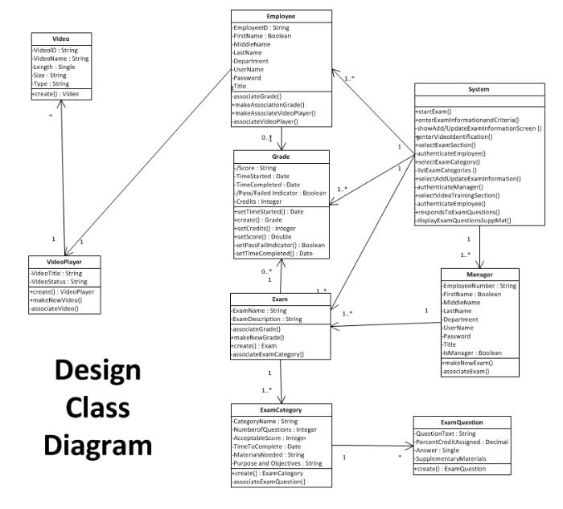
Object-Oriented Analysis and Design and the Unified Process

Slide 29
Some Fundamental Design Principles
Encapsulation
  Each object is a self-contained unit containing both data and program logic
Object reuse
  Standard objects can be used over and over again within a system
Information hiding
  Data associated with an object is not visible
  Methods provide access to data
Object-Oriented Analysis and Design and the Unified Process

Slide 30
Some Fundamental Design Principles (continued)
Navigation visibility
  Describes which objects can interact with each other
Coupling
  Measures how closely classes are linked
Cohesion
  Measures the consistency of functions in a class
Separation of responsibilities
  Divides a class into several highly cohesive classes
Object-Oriented Analysis and Design and the Unified Process

Slide 31
Cohesion refers to the degree to which the elements of a module/class belong together, it is suggested that the related code should be close to each other, so we should strive for high cohesion and bind all related code together as close as possible. It has to do with the elements within the module/class.
Coupling refers to the degree to which the different modules/classes depend on each other, it is suggested that all modules should be independent as far as possible, that's why low coupling. It has to do with the elements among different modules/classes.
Object-Oriented Analysis and Design and the Unified Process

Slide 32
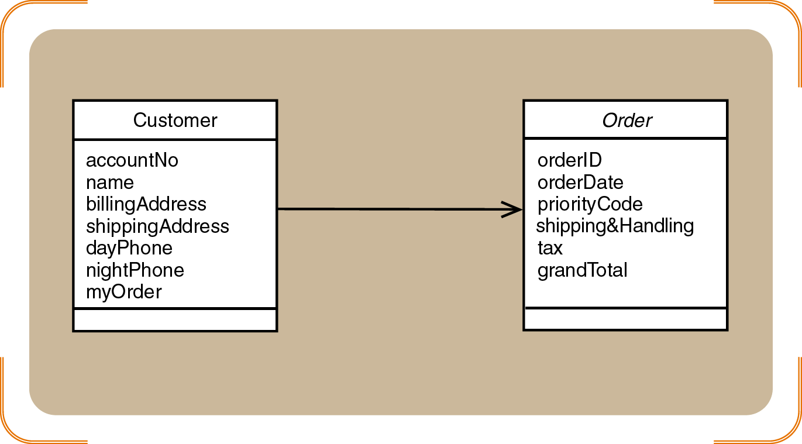
Figure 8-8
Navigation visibility between Customer and Order - coupling
Object-Oriented Analysis and Design and the Unified Process

Slide 33
Developing the First-Cut Design Class Diagram
Elaborate the attributes with type and initial value information
  Most attributes should be private
Add navigation visibility arrows
  Based on which classes need access to which other classes
  Can be bidirectional
  Will need to be updated as design progresses
Object-Oriented Analysis and Design and the Unified Process

Slide 34
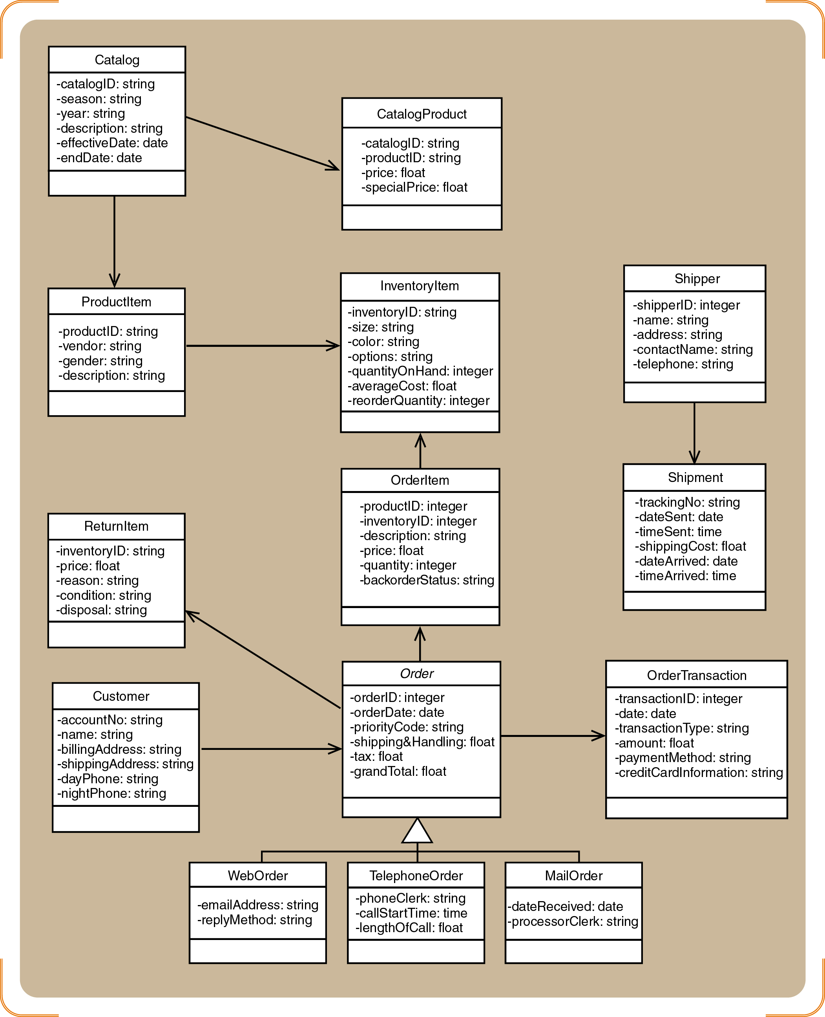
Figure 8-10
First-cut RMO design class diagram
Object-Oriented Analysis and Design and the Unified Process

Slide 35
Interaction Diagrams–Realizing Use Cases and Defining Methods
Interaction diagrams are at the heart of object-oriented design
Realization of a use case
  Determine what objects collaborate by sending messages to each other
Two types
  Sequence
  Communication
Object-Oriented Analysis and Design and the Unified Process

Slide 36
Object Responsibility
Objects are responsible for carrying out system processing
Two major areas of responsibility
  Knowing
    Knowledge about its own data and about other classes with which it must collaborate to carry out use cases
  Doing
    All the activities an object does to assist in the execution of a use case
Object-Oriented Analysis and Design and the Unified Process

Slide 37
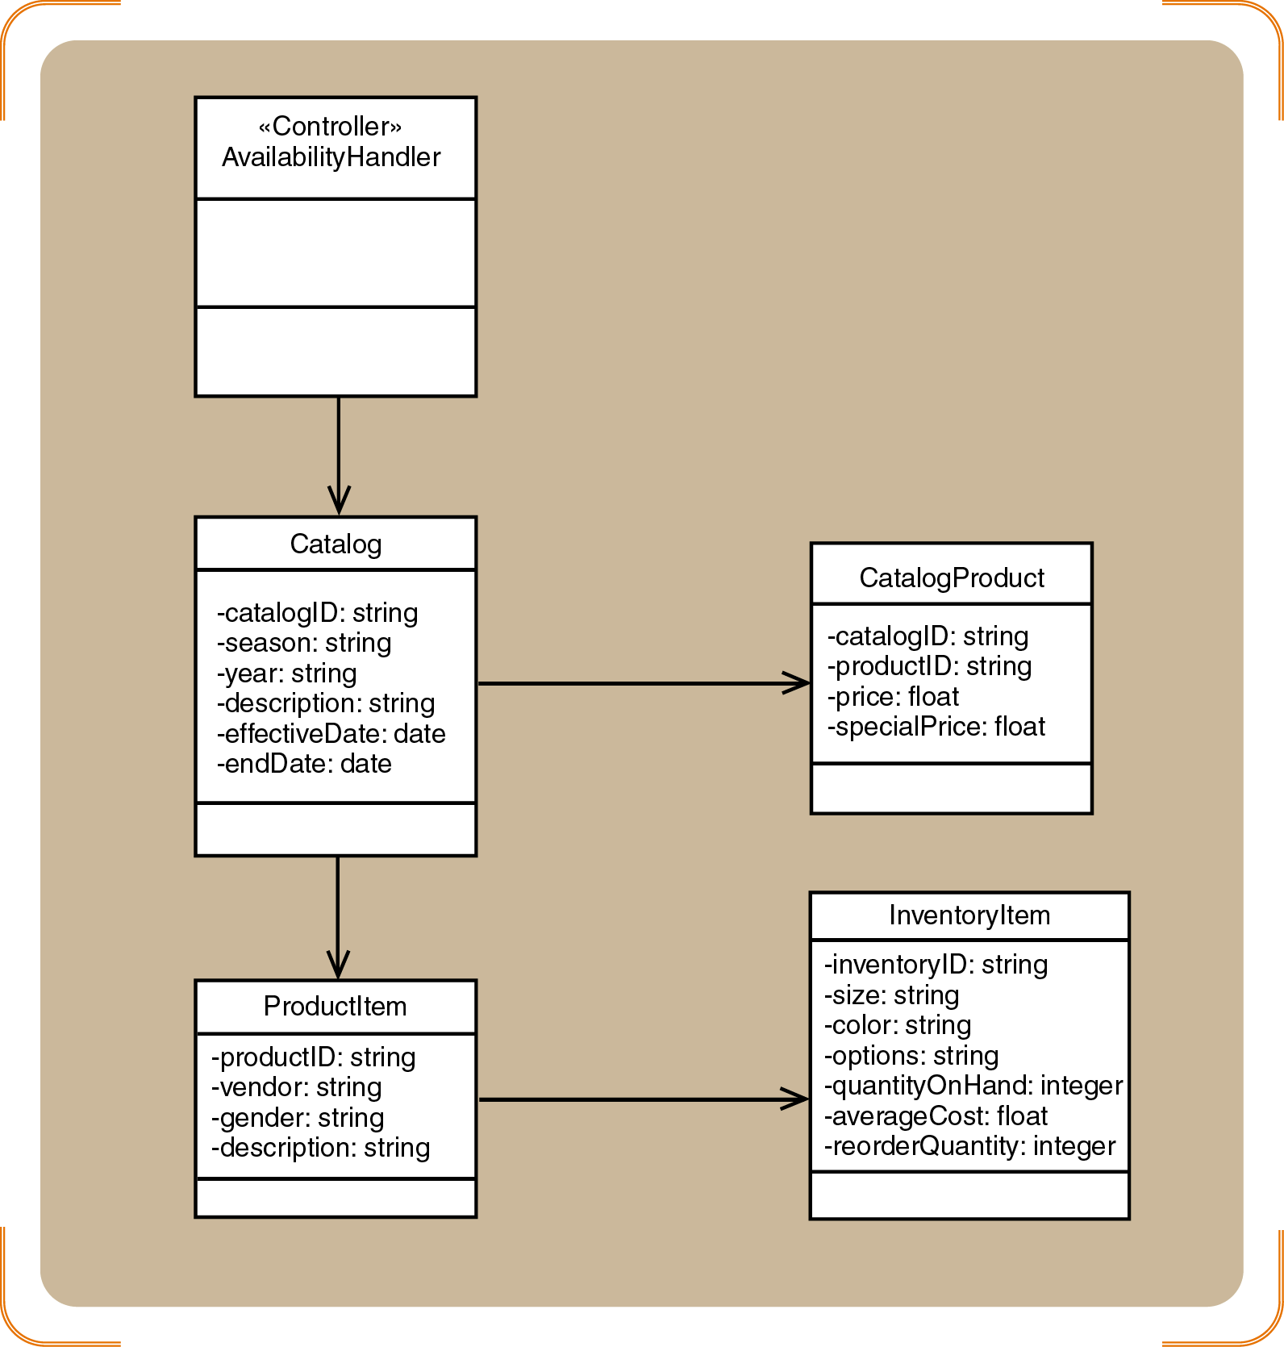
Figure 8-11
Partial design class diagram for the Look up item availability use case
Object-Oriented Analysis and Design and the Unified Process

Slide 38
Use Case Controller
An artifact invented by the designer to handle a system function
  Serves as a collection point for incoming messages
  Intermediary between the outside world and the internal system
A single use case controller results in low cohesion
Several use case controllers raise coupling but result in high cohesion
Object-Oriented Analysis and Design and the Unified Process

Slide 39
Designing with Sequence Diagrams
An SSD captures the interactions between the system and the external world represented by actors
  The system is treated like a black box
A detailed sequence diagram uses all of the same elements as an SSD
  The :System object is replaced by all of the internal objects and messages within the system
Object-Oriented Analysis and Design and the Unified Process

Slide 40
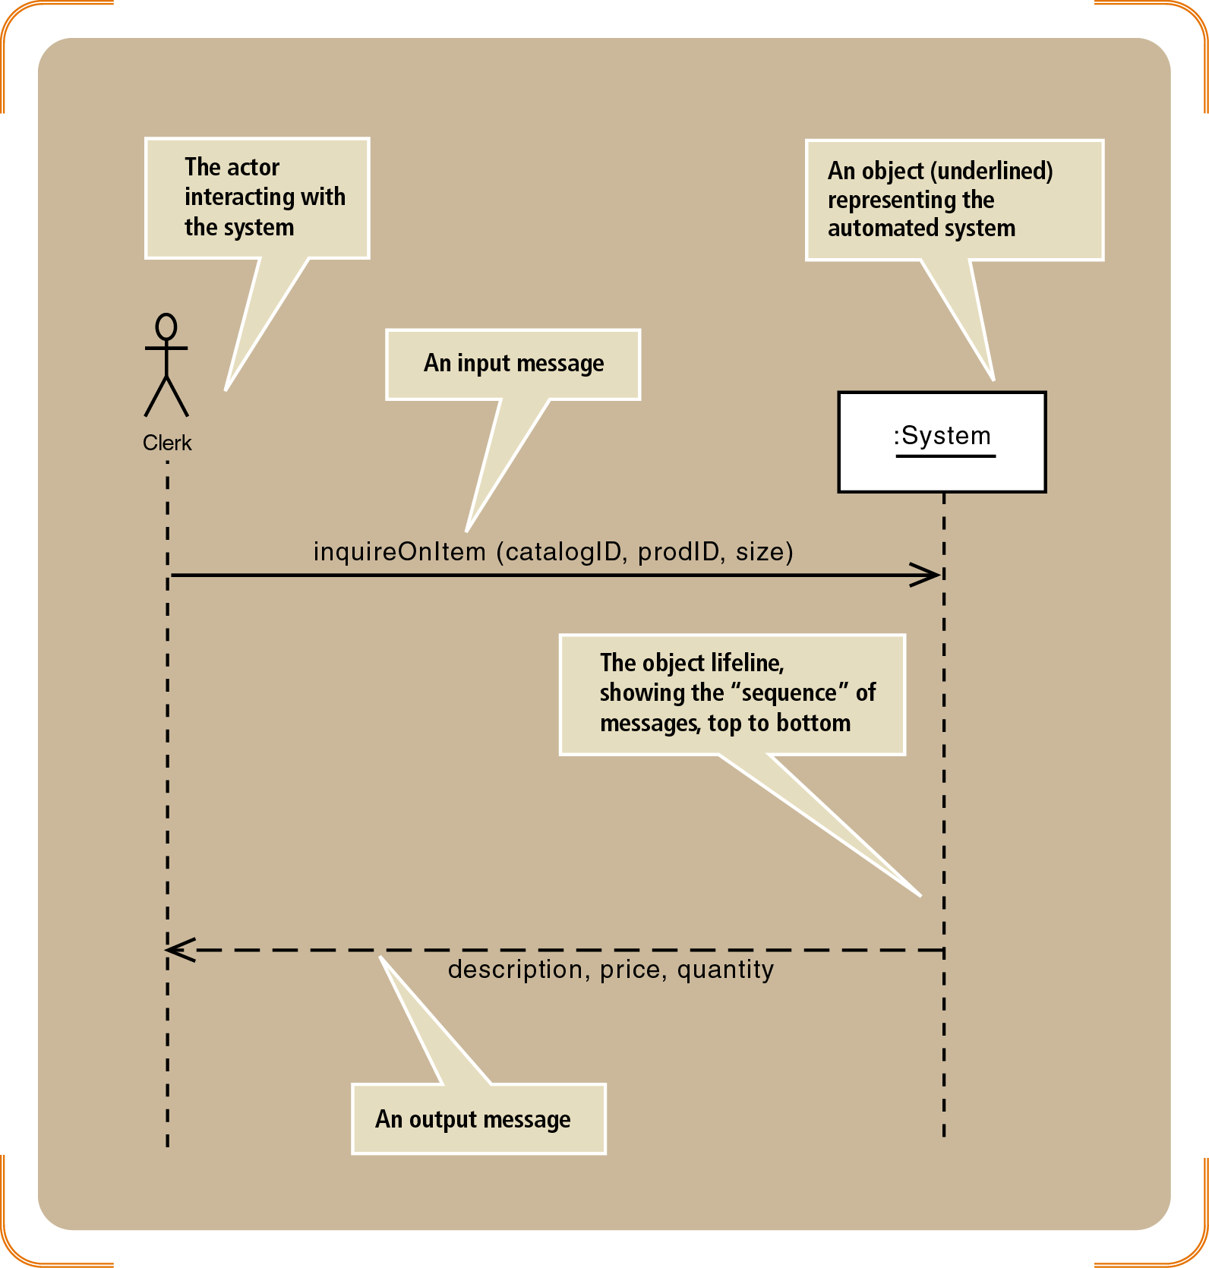
Figure 8-12
SSD for the Look up item availability use case
Object-Oriented Analysis and Design and the Unified Process

Slide 41
First-Cut Sequence Diagram
Determine which other objects may need to be involved to carry out the use case
Replace the :System object with a use case controller object
Determine which other messages will be sent
  Define the source and destination object for each message
Use activation lifelines to indicate when an object is executing a method
Object-Oriented Analysis and Design and the Unified Process

Slide 42
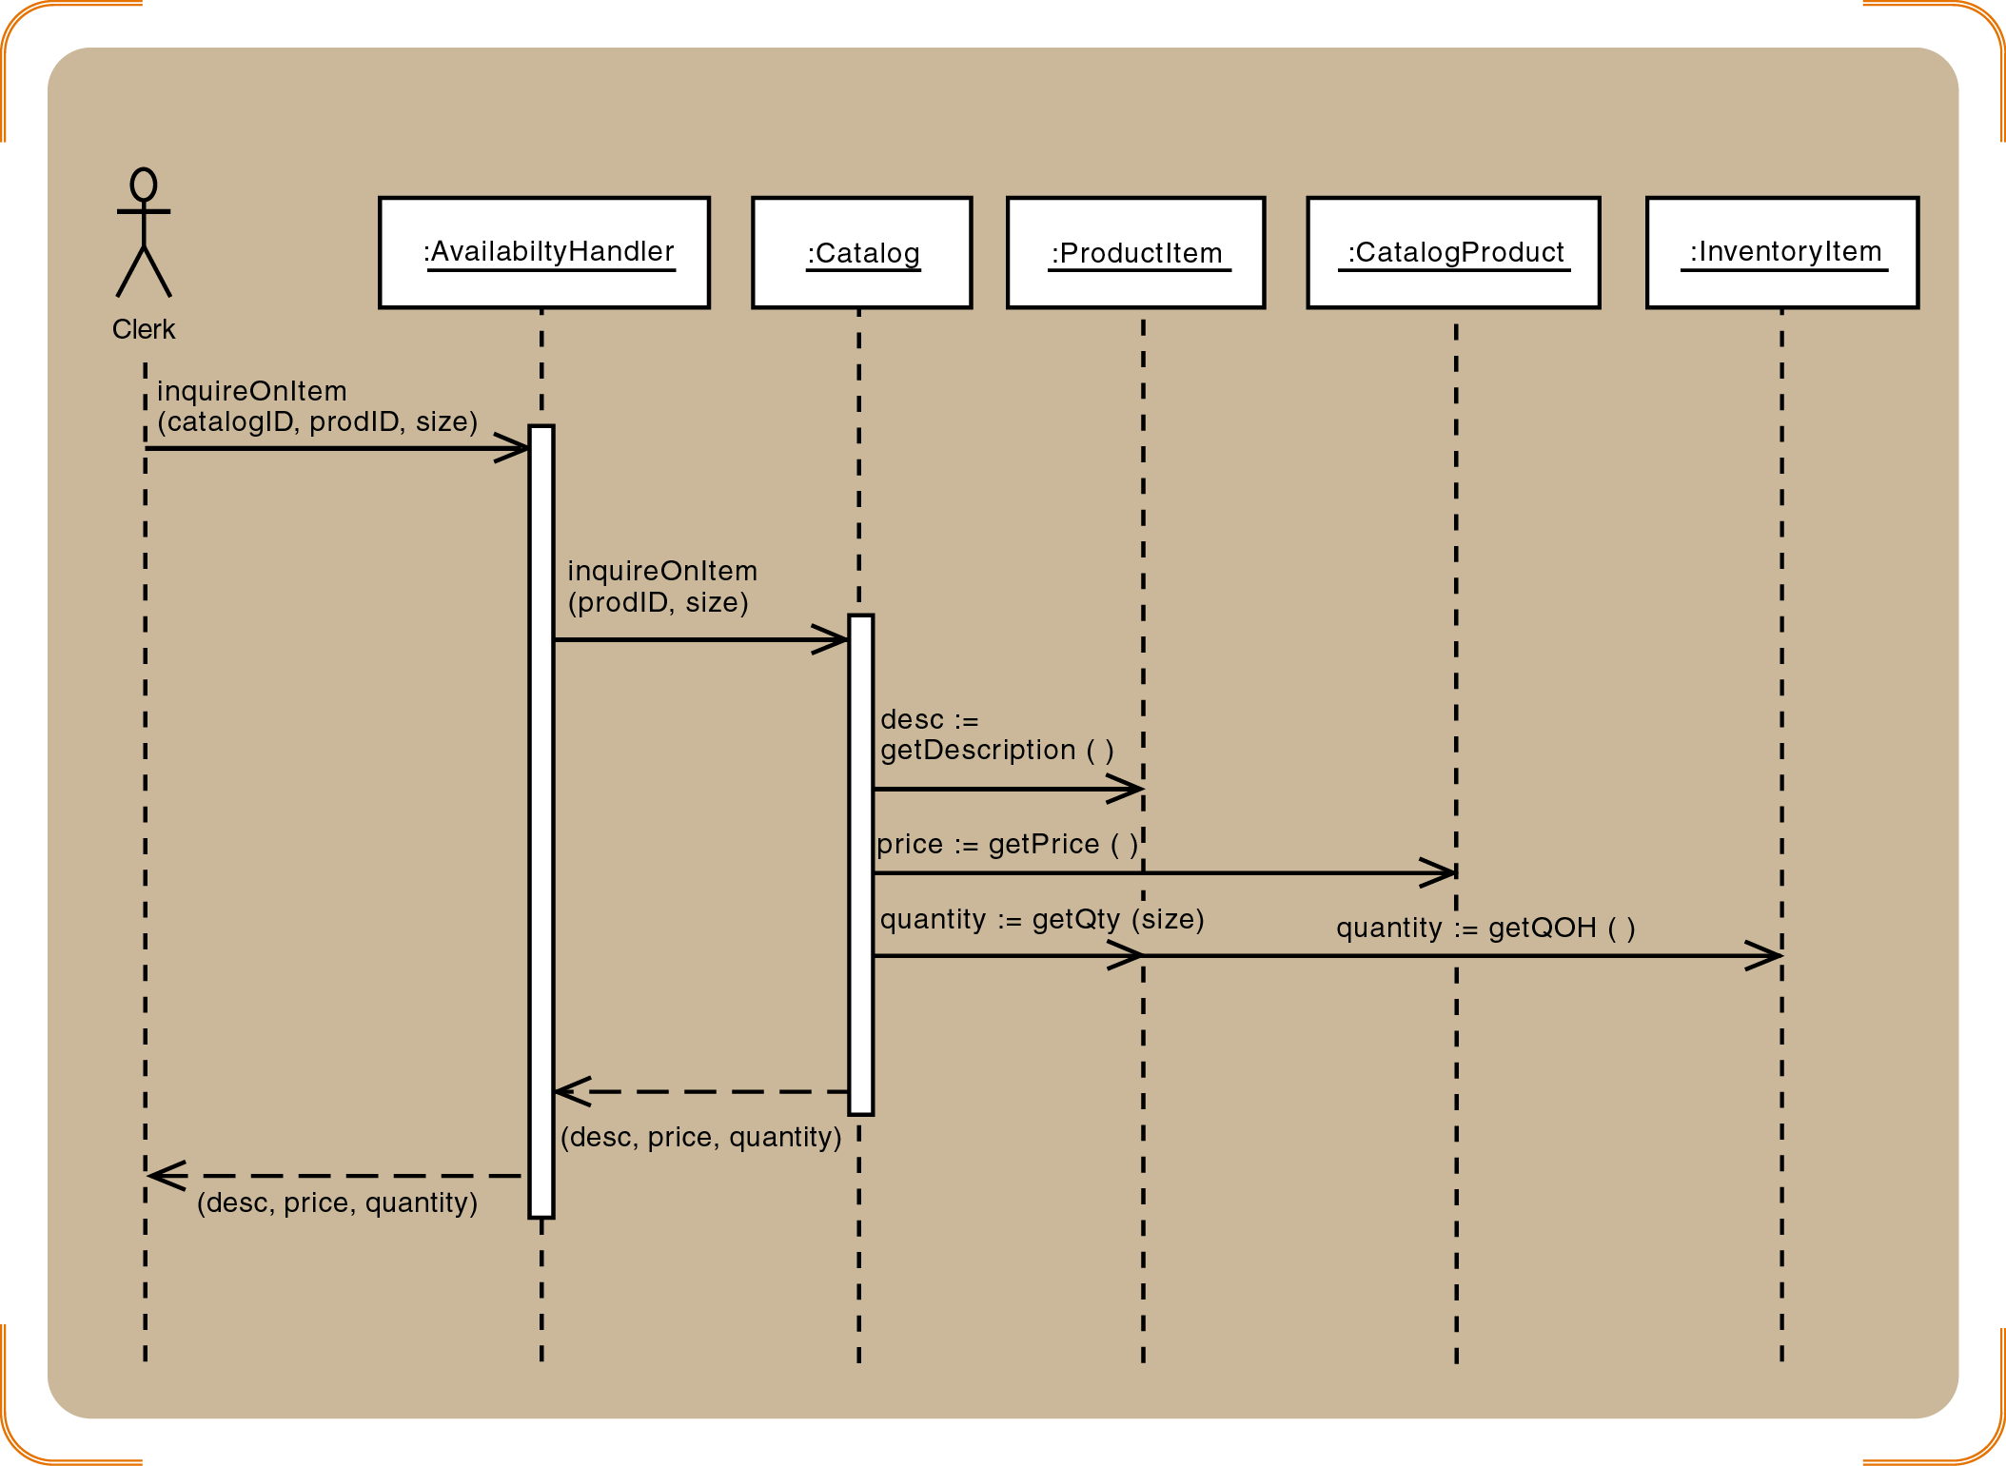
Figure 8-14
First-cut sequence diagram for the Look up item availability use case
Object-Oriented Analysis and Design and the Unified Process

Slide 43
Guidelines for Preliminary Sequence Diagram Development
Determine all of the internal messages that result from each input message
  Define origin and destination objects
Identify the complete set of classes that will be affected by each message
Flesh out the components for each message
  Iteration, true/false conditions, return values, and passed parameters
Object-Oriented Analysis and Design and the Unified Process

Slide 44
Developing a Multilayer Design
View layer
  Design the user interface for each use case
  Develop dialog designs for forms
  Add the window classes to the sequence diagram
Data access layer
  Initialize domain objects with data from the database
  Query the database and send a reference object
  Return information in the reference object
Object-Oriented Analysis and Design and the Unified Process

Slide 45
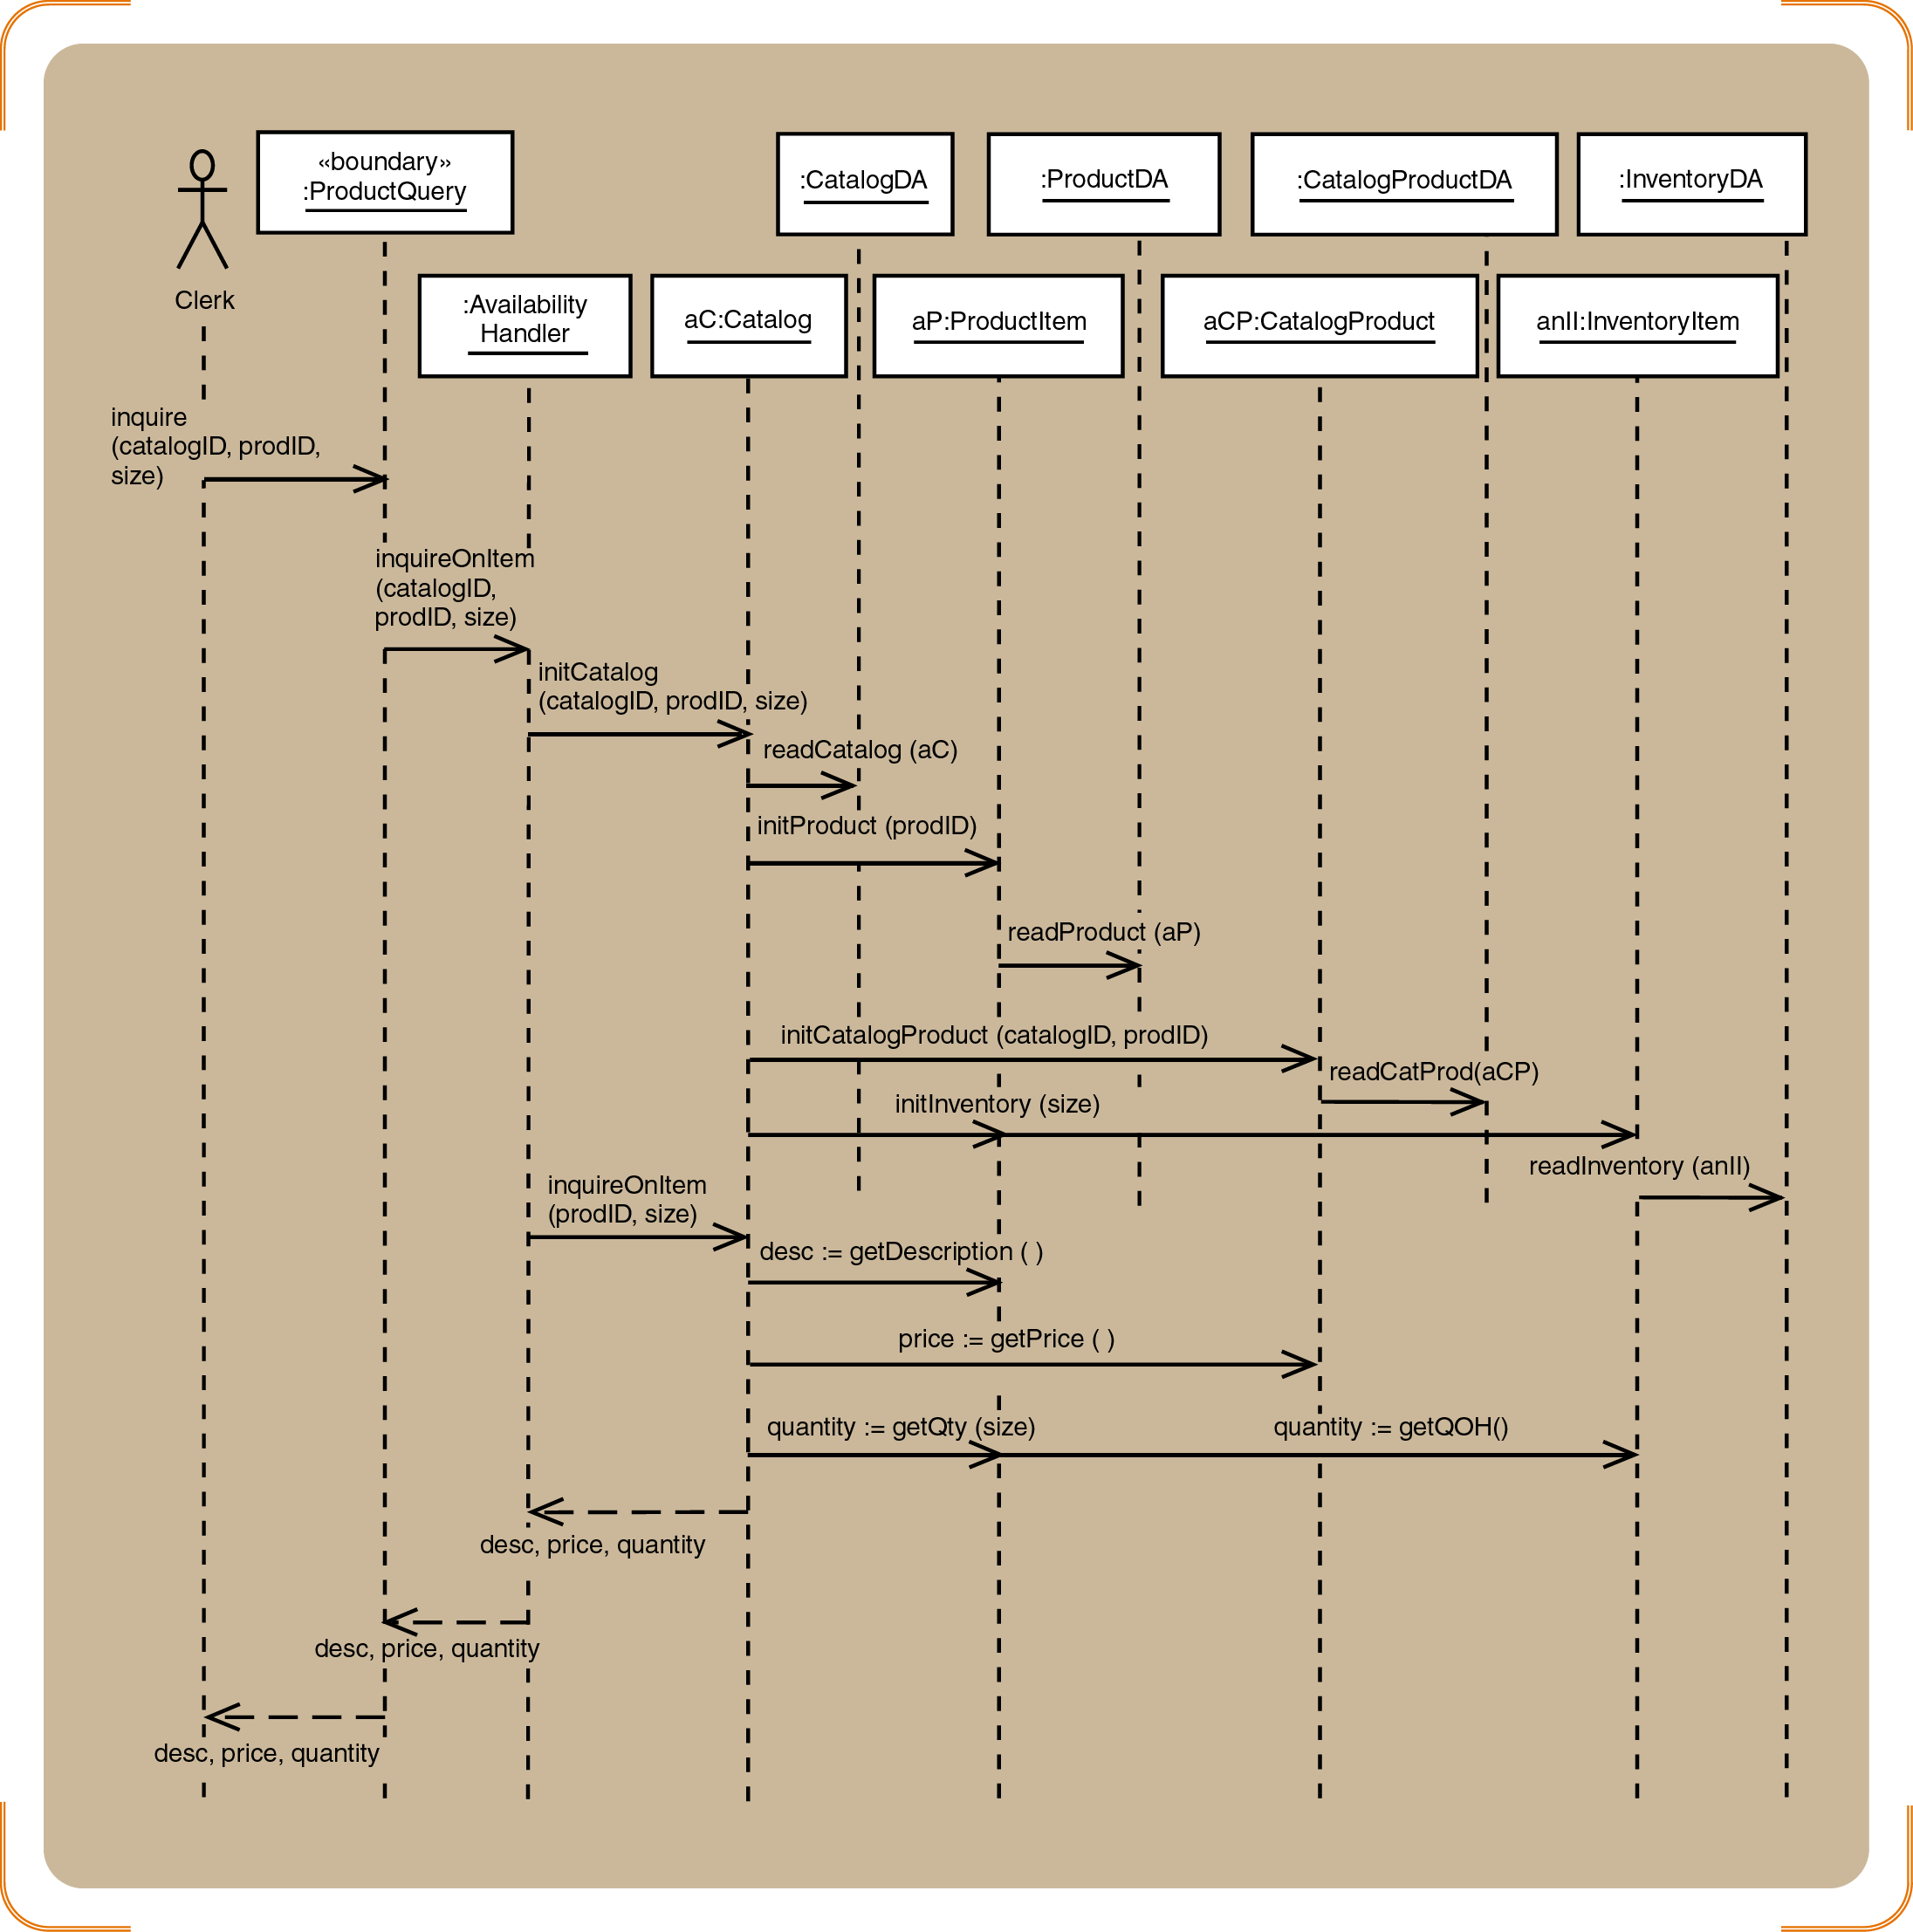
Figure 8-17
Completed three-layer design for Look up item availability
Object-Oriented Analysis and Design and the Unified Process

Slide 46
A First-Cut Sequence Diagram for an RMO Telephone Order
Define a user controller object
Define a “create” message for new Order objects
  Customer object creates the Order object
Define other messages
  addItem, createOrdItem, getDescription, getPrice, updateQty
Identify source, destination, and navigation visibility for each message
Object-Oriented Analysis and Design and the Unified Process

Slide 47
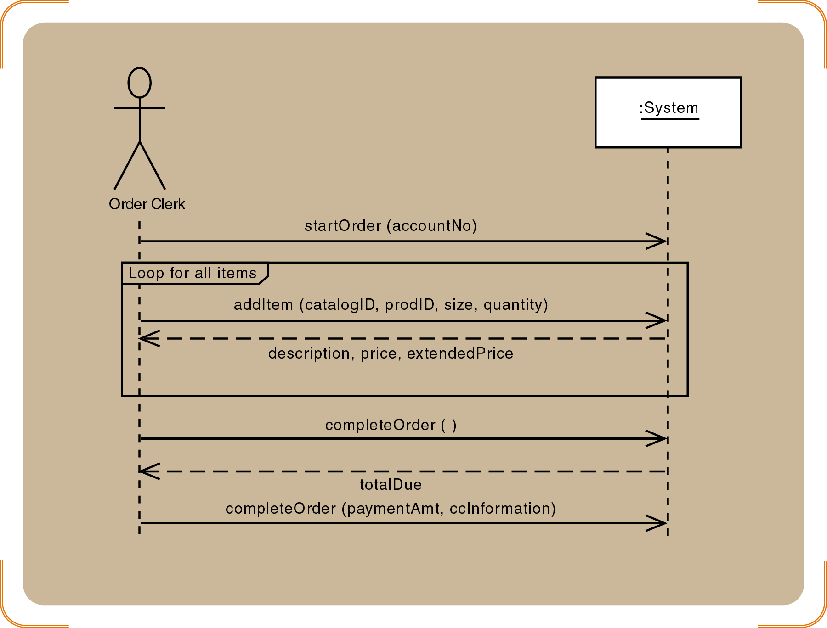
Figure 8-18
SSD for the telephone order scenario of the Create new order use case
Object-Oriented Analysis and Design and the Unified Process

Slide 48
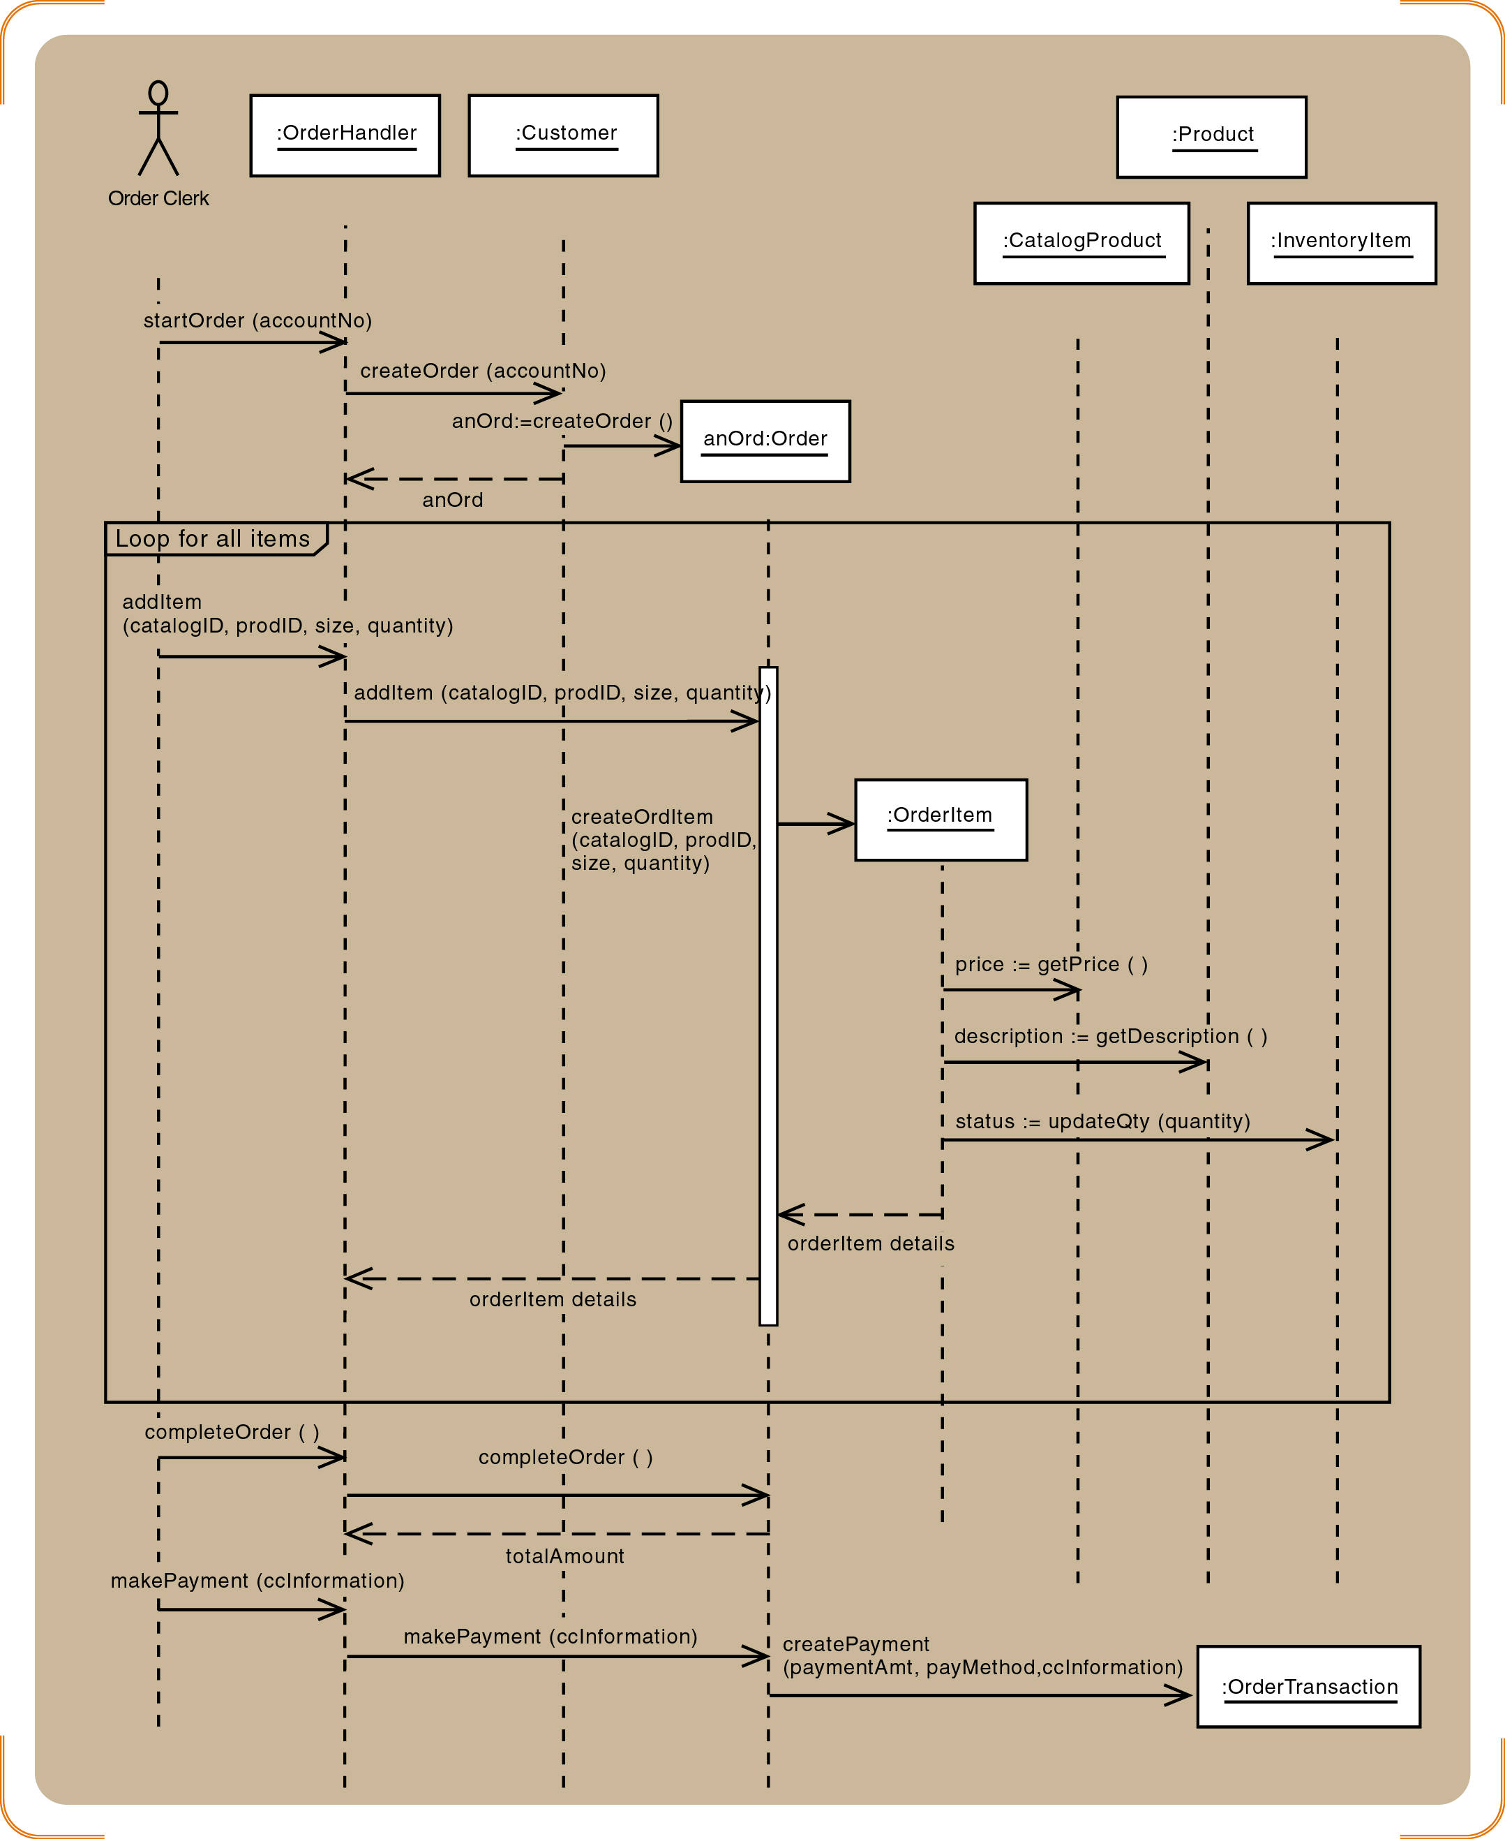
Figure 8-21
Sequence diagram for the
telephone order scenario of the Create new order use case
Object-Oriented Analysis and Design and the Unified Process

Slide 49
Developing a Multilayer Design for the Telephone Order Scenario
Extend one message at a time
View layer
  Open Order window and return a Customer object
Data layer
  Customer object initializes itself
  Add items to an order with a repeating message
  Save Order and OrderItem to the database
  Update database inventory
  Complete transaction
Object-Oriented Analysis and Design and the Unified Process

Slide 50
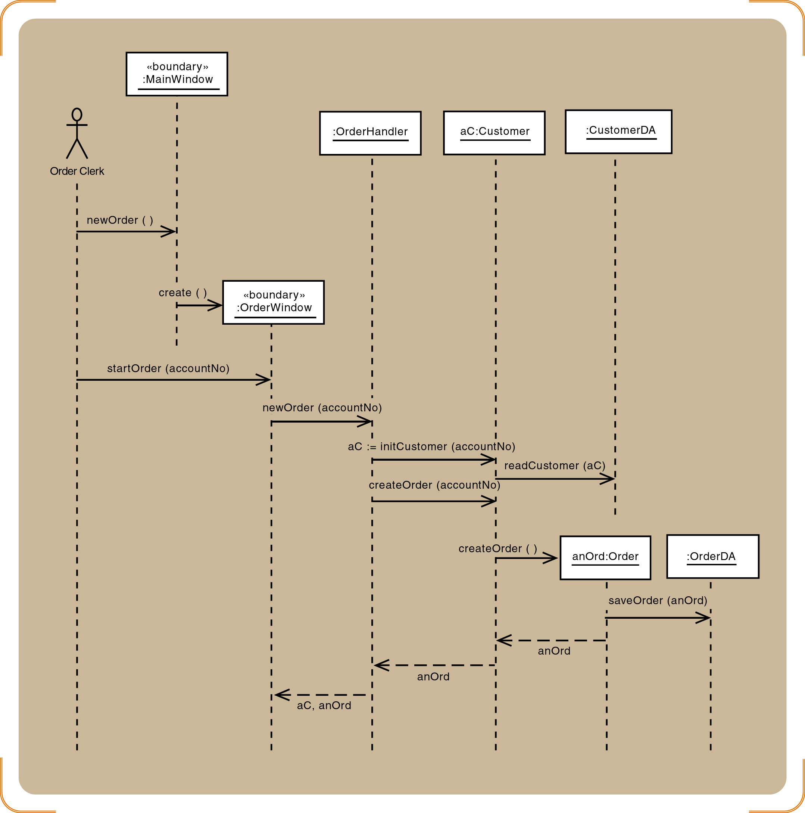
Figure 8-22
Telephone order sequence diagram for the startOrder message
Object-Oriented Analysis and Design and the Unified Process

Slide 51
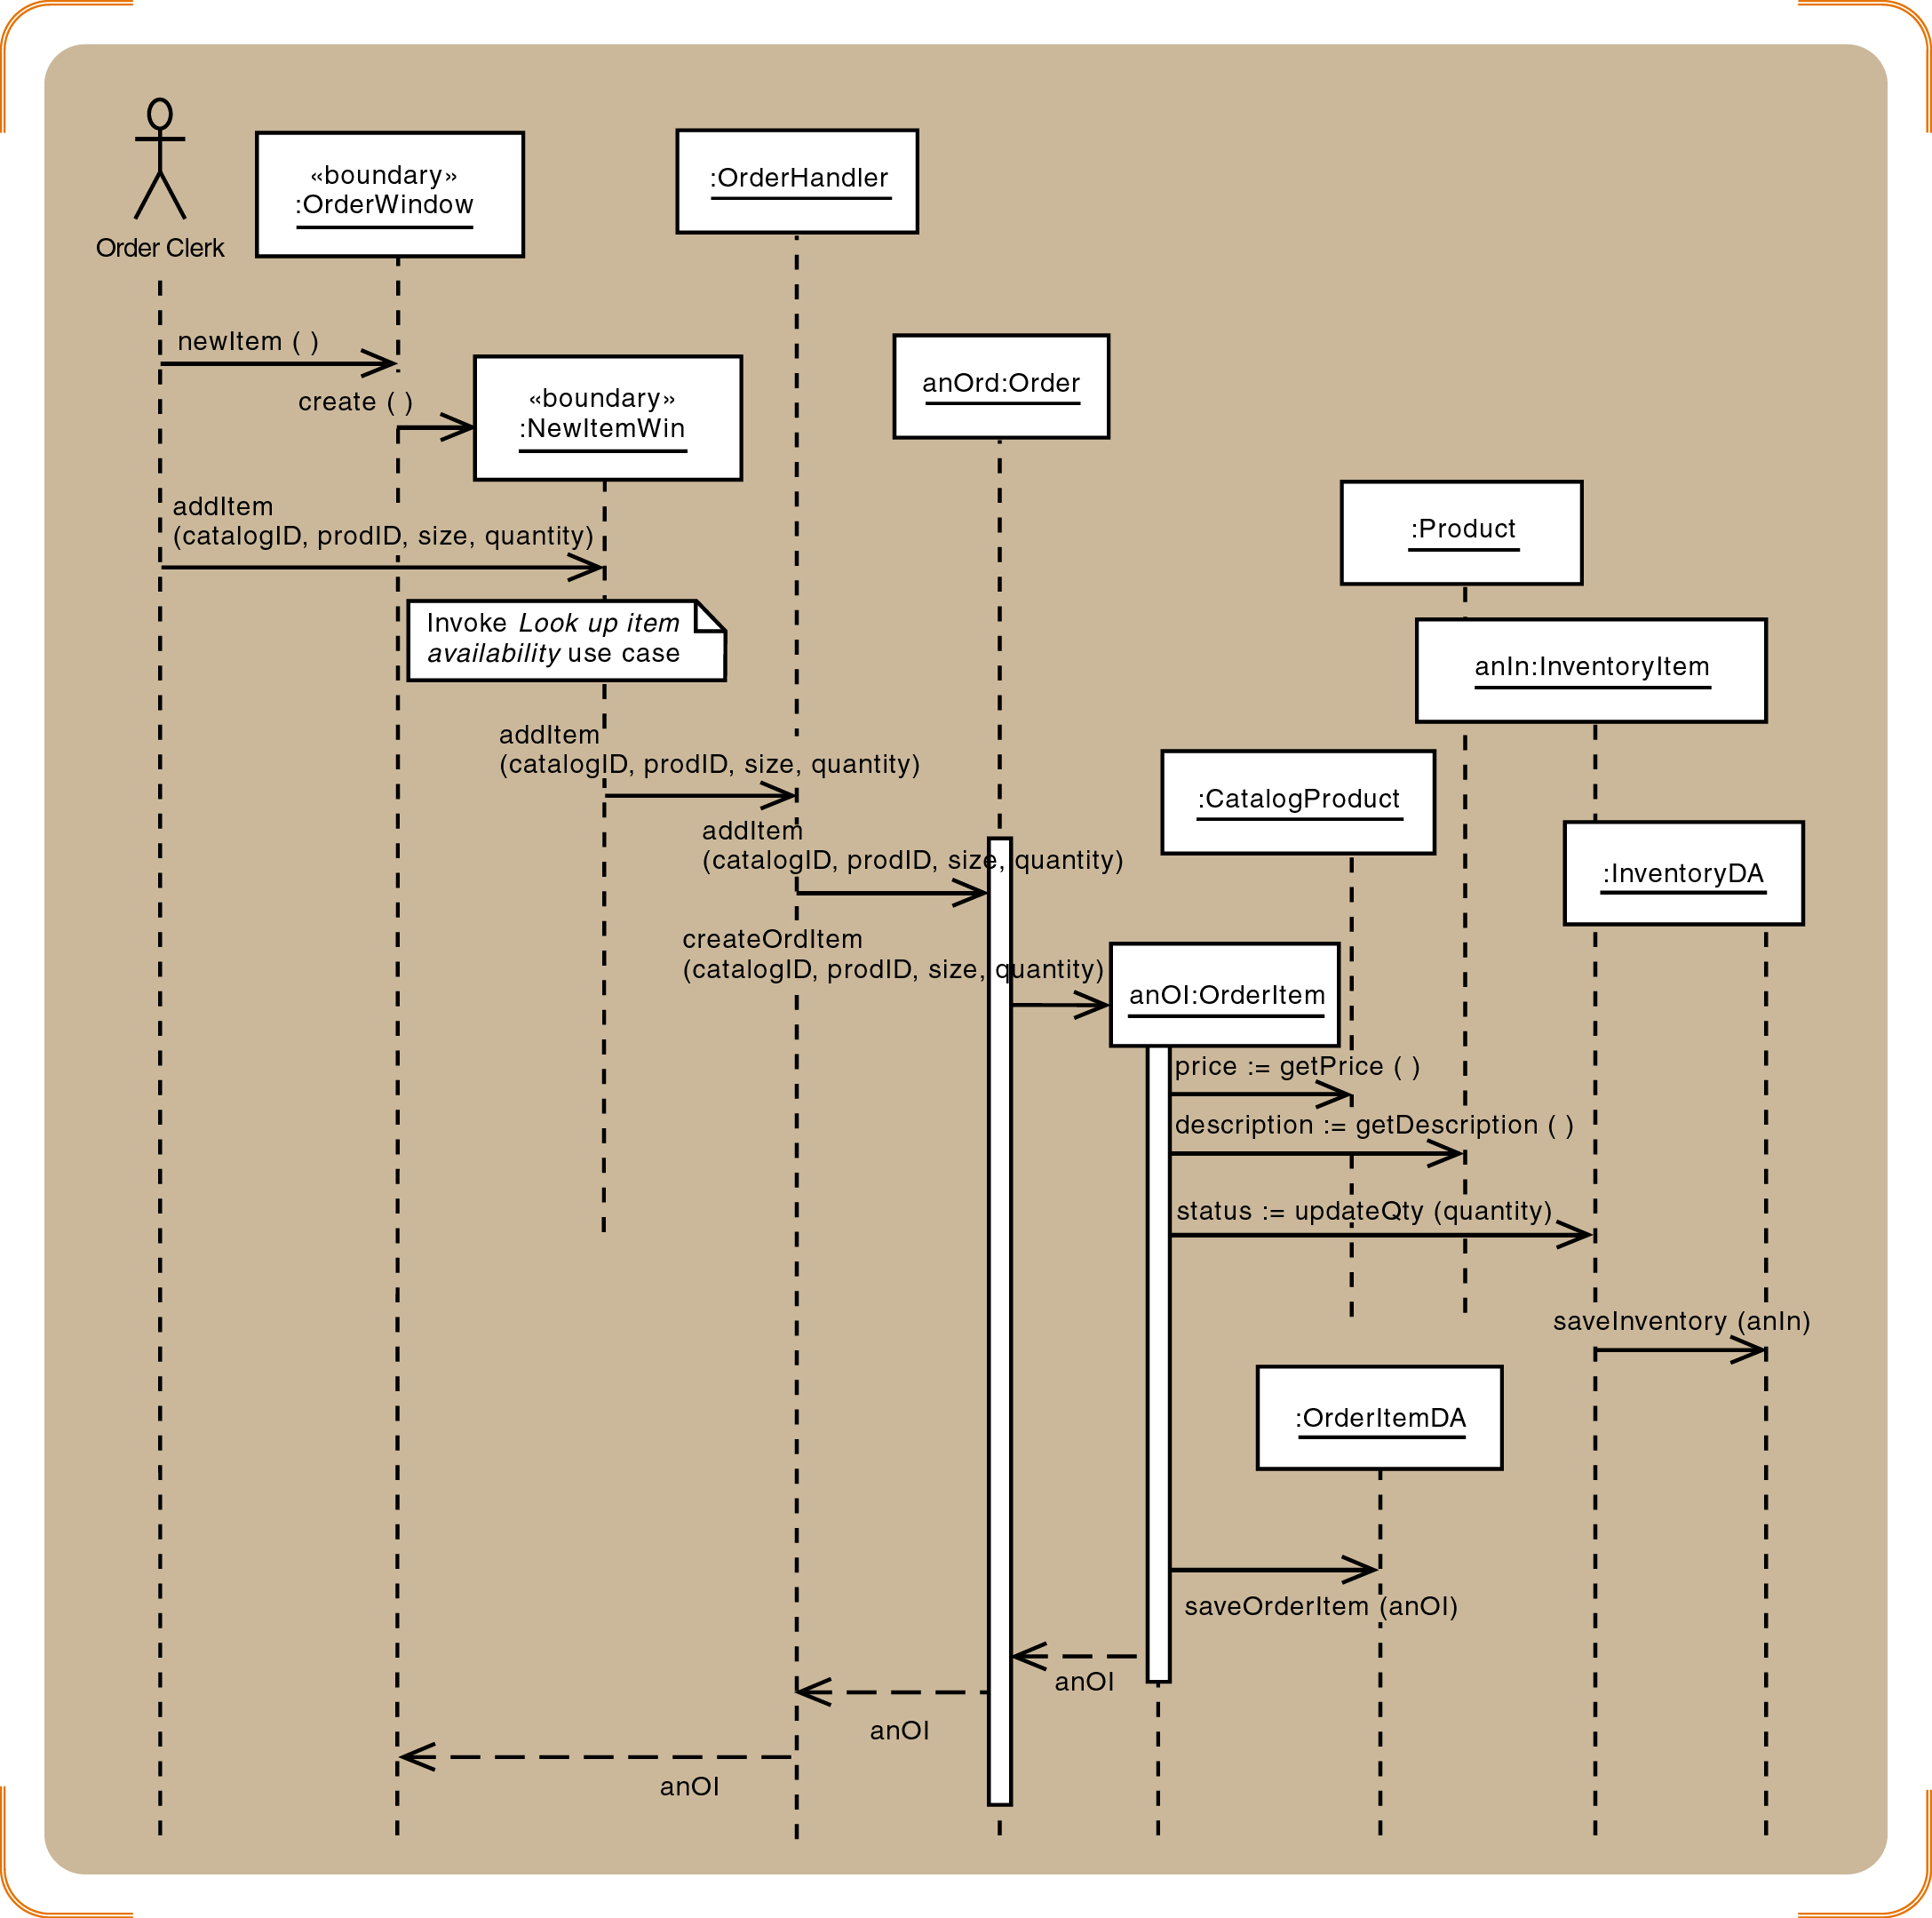
Figure 8-23
Telephone order sequence diagram for the addItem message
Object-Oriented Analysis and Design and the Unified Process

Slide 52
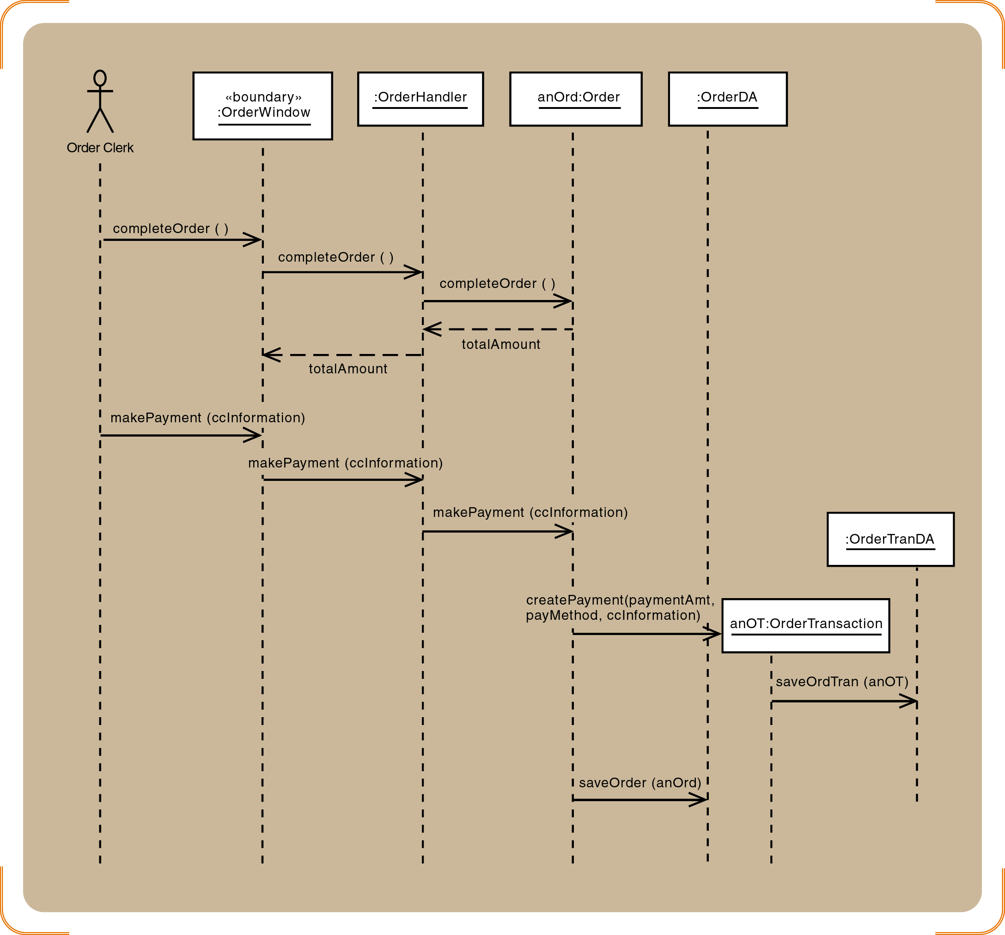
Figure 8-24
Telephone order sequence diagram for the final messages
Object-Oriented Analysis and Design and the Unified Process

Slide 53
Designing with Communication Diagrams
Shows a view of the use case that emphasizes coupling
Uses the same symbols as a sequence diagram for actors, objects, and messages
Lifeline symbols are not used
Link symbols indicate that two items share a message
Numbers indicate the sequence in which messages are sent
Object-Oriented Analysis and Design and the Unified Process

Slide 54
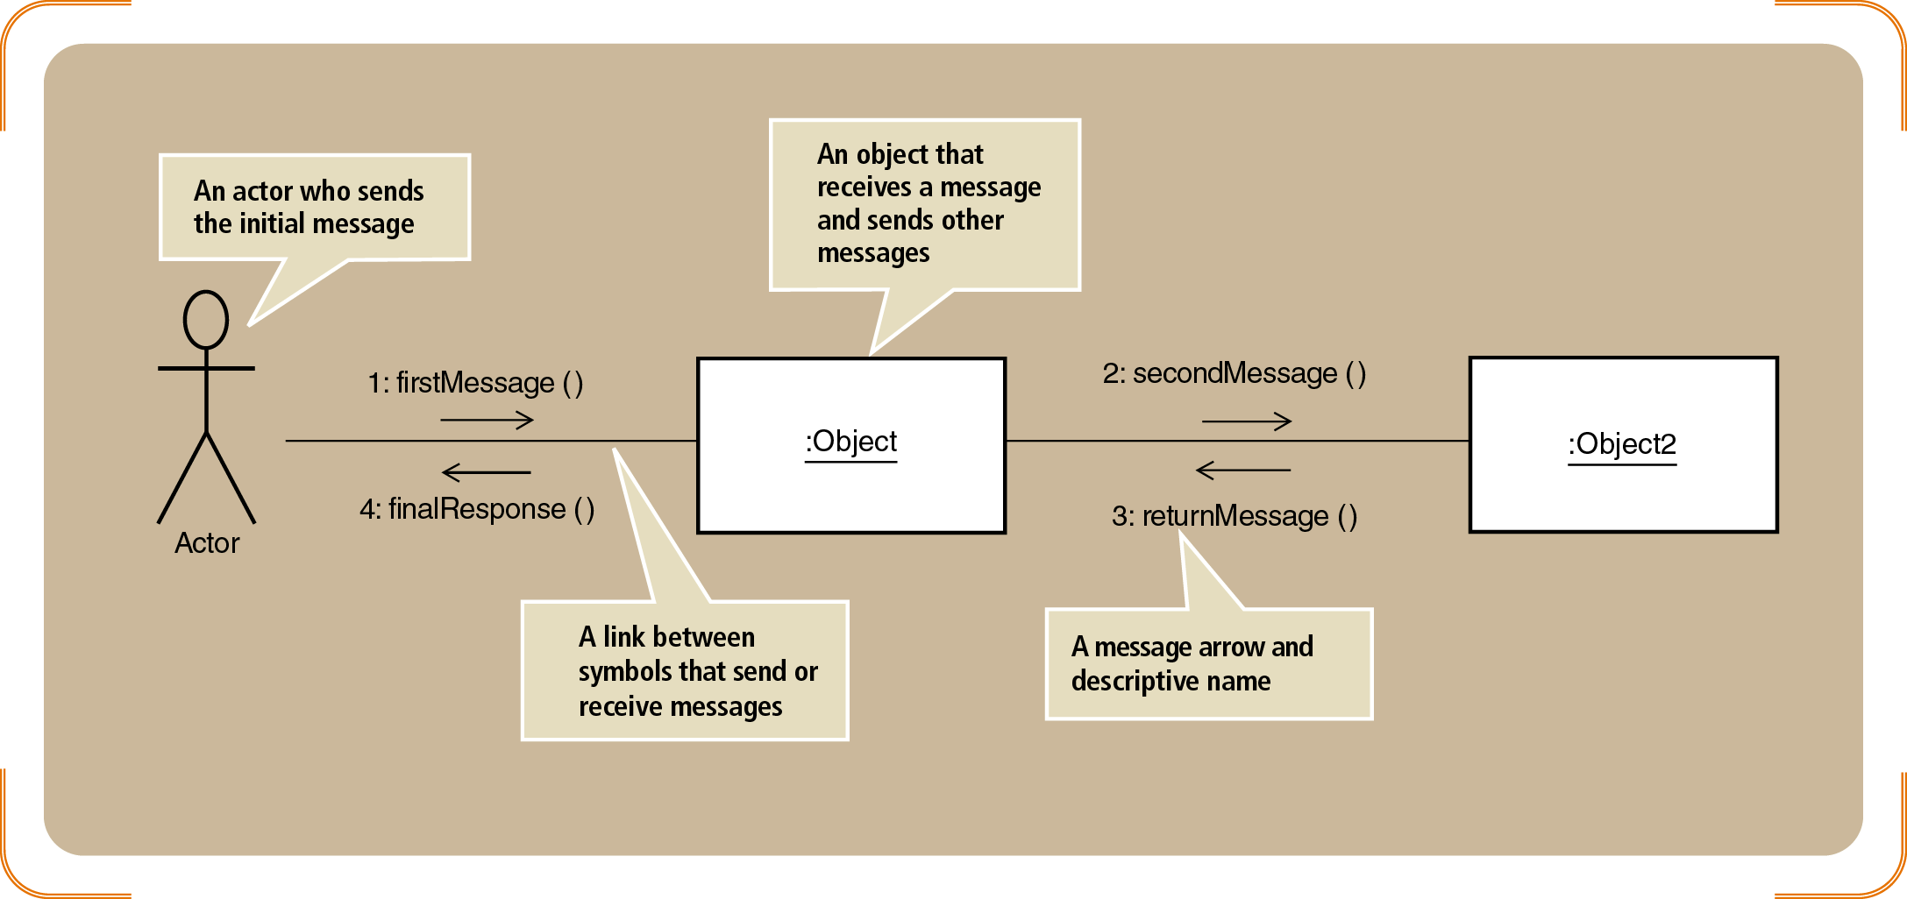
Figure 8-25
The symbols of a communication diagram
Object-Oriented Analysis and Design and the Unified Process

Slide 55
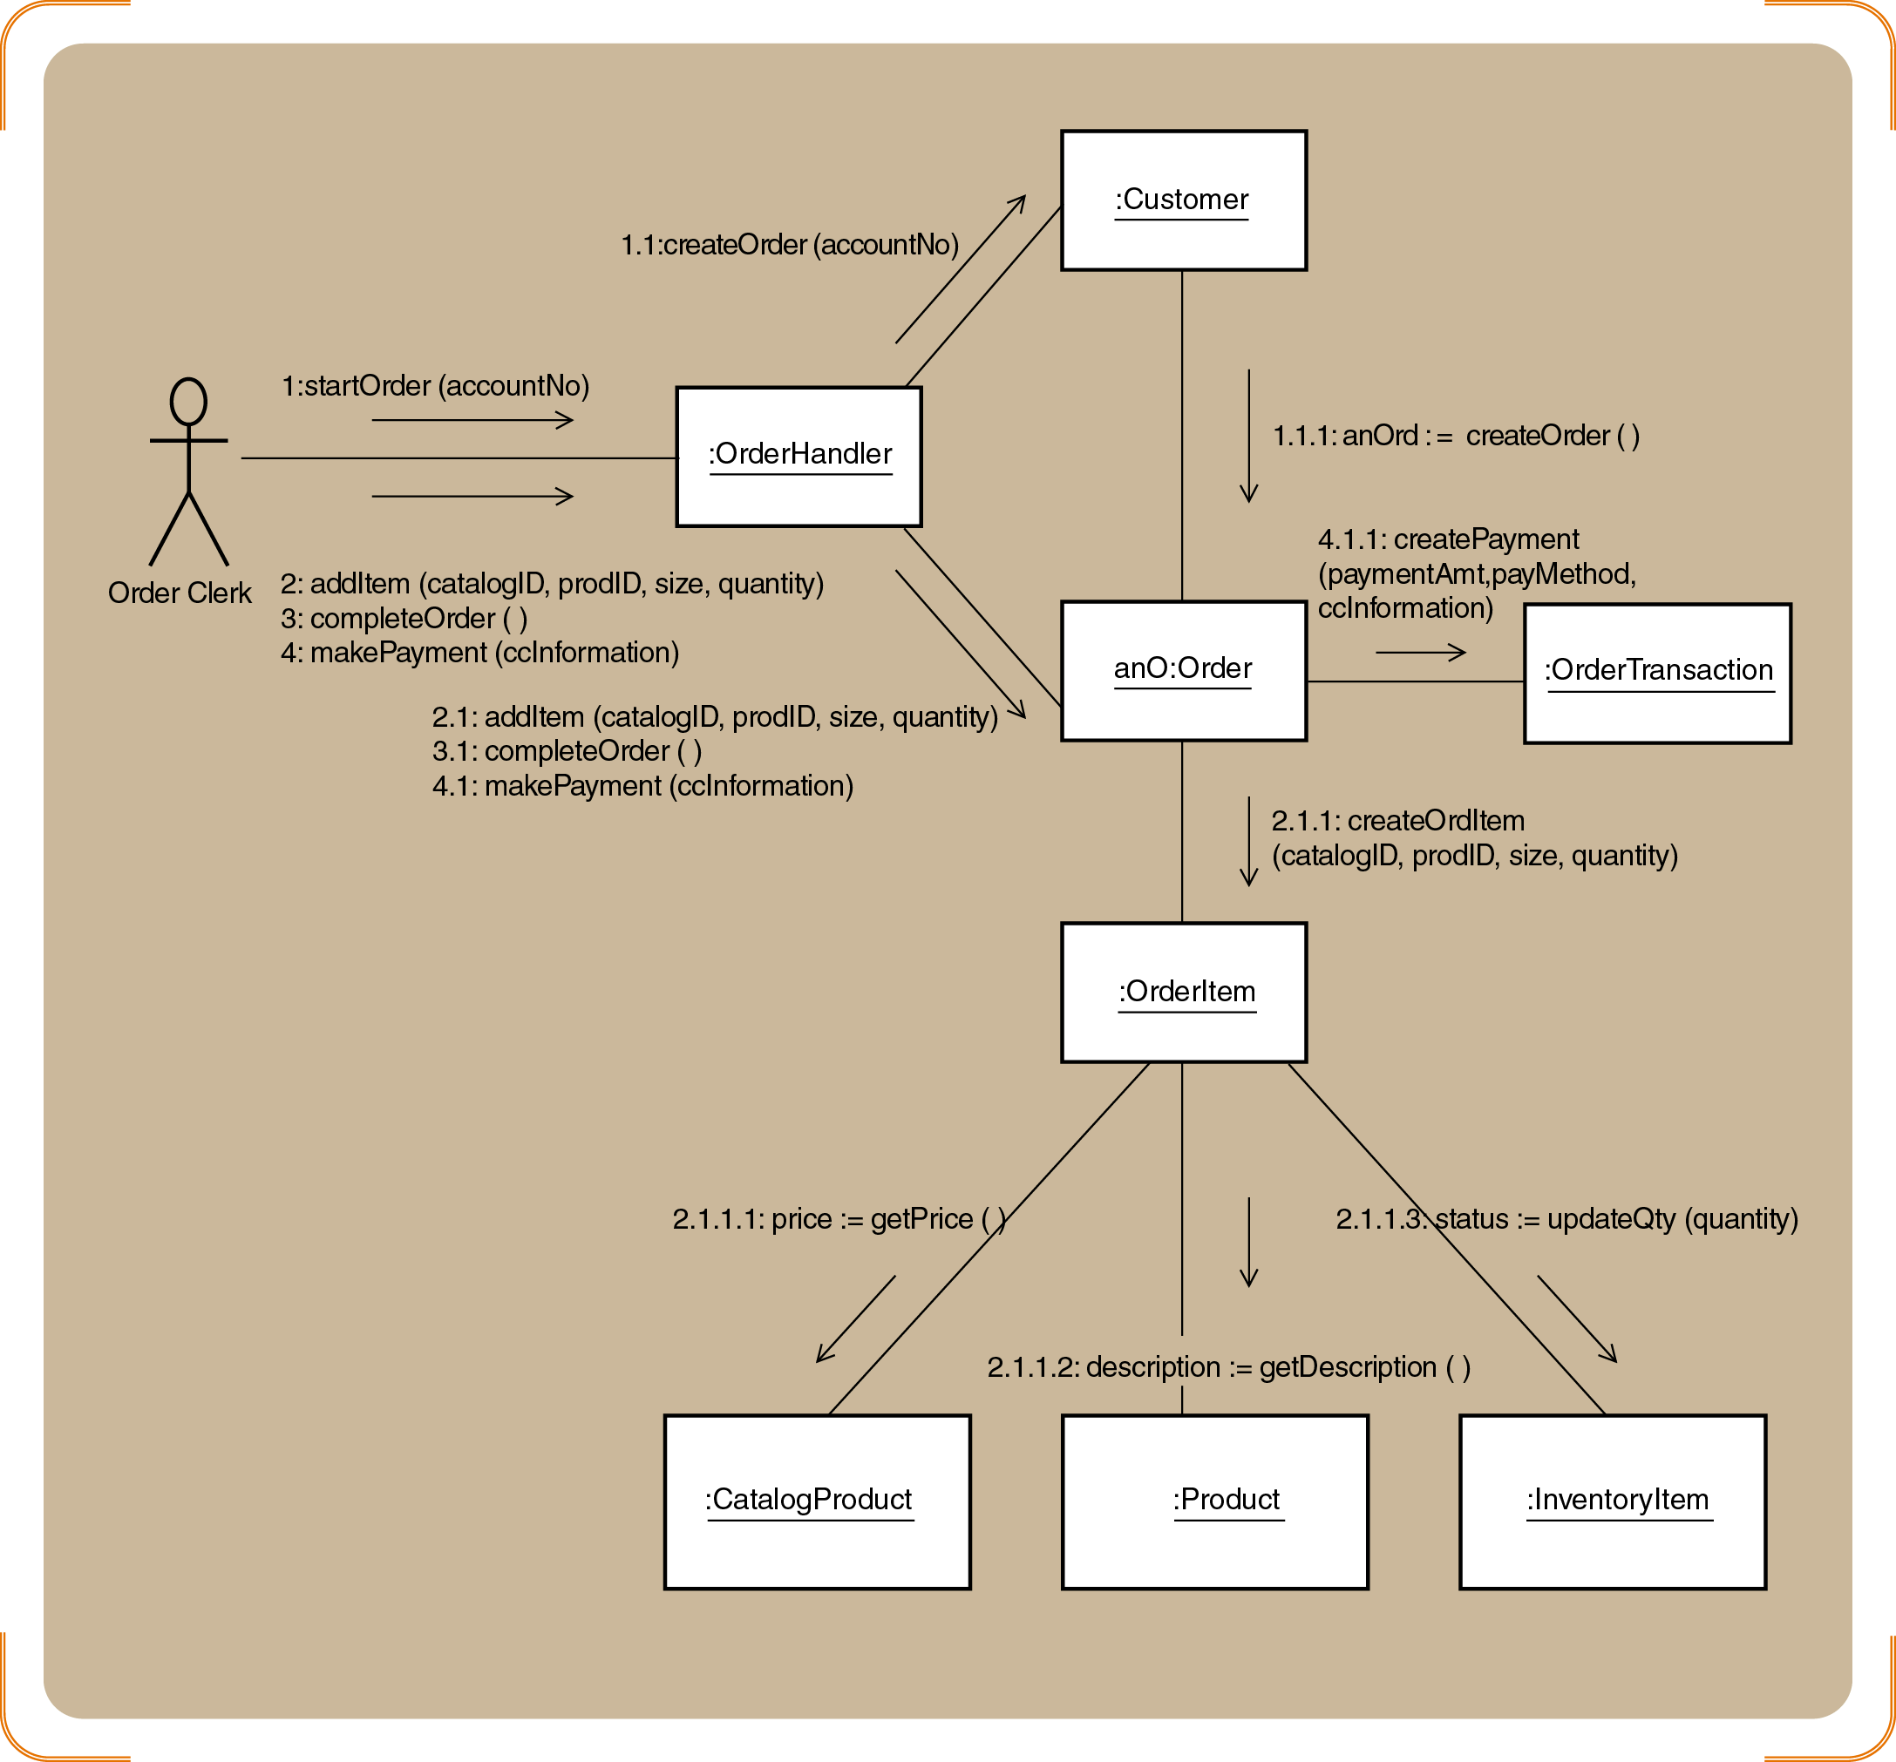
Figure 8-27
A communication diagram for Create new order
Object-Oriented Analysis and Design and the Unified Process

Slide 56
Updating the Design Class Diagram
Add classes for the view and data access layers
Update classes with method signatures
  Constructor and get and set methods are optional
  Use case specific methods are required
Every message in a sequence diagram requires a method in the destination object
Include the new user controller classes and add navigation arrows
Object-Oriented Analysis and Design and the Unified Process

Slide 57
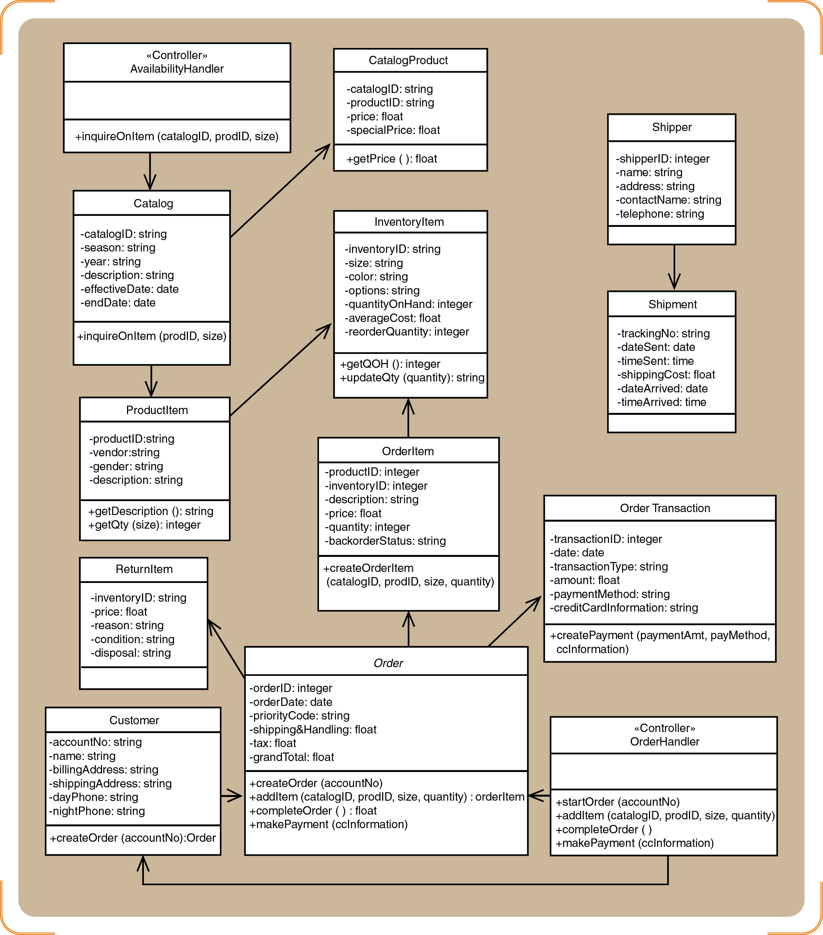
Figure 8-30
Updated design class diagram for the domain layer
Object-Oriented Analysis and Design and the Unified Process

Slide 58
Package Diagrams-Structuring the Major Components
Associates classes of related groups
One option is to separate the view, domain, and data access layers into separate packages
Indicate dependency relationships
  Shows which elements affect other elements in a system
  May exist between packages, or between classes within packages
Packages can be nested
Object-Oriented Analysis and Design and the Unified Process

Slide 59
Implementation Issues for Three-Layer Design
IDE (Integrated Development Environment) tools can help programmers construct systems
IDE tools can also make a system difficult to maintain
  Creates window classes that generate class definitions
  Inserts business logic code into the user interface
Use good design principles when developing a system
  Define object responsibility for each layer
Object-Oriented Analysis and Design and the Unified Process

Slide 60
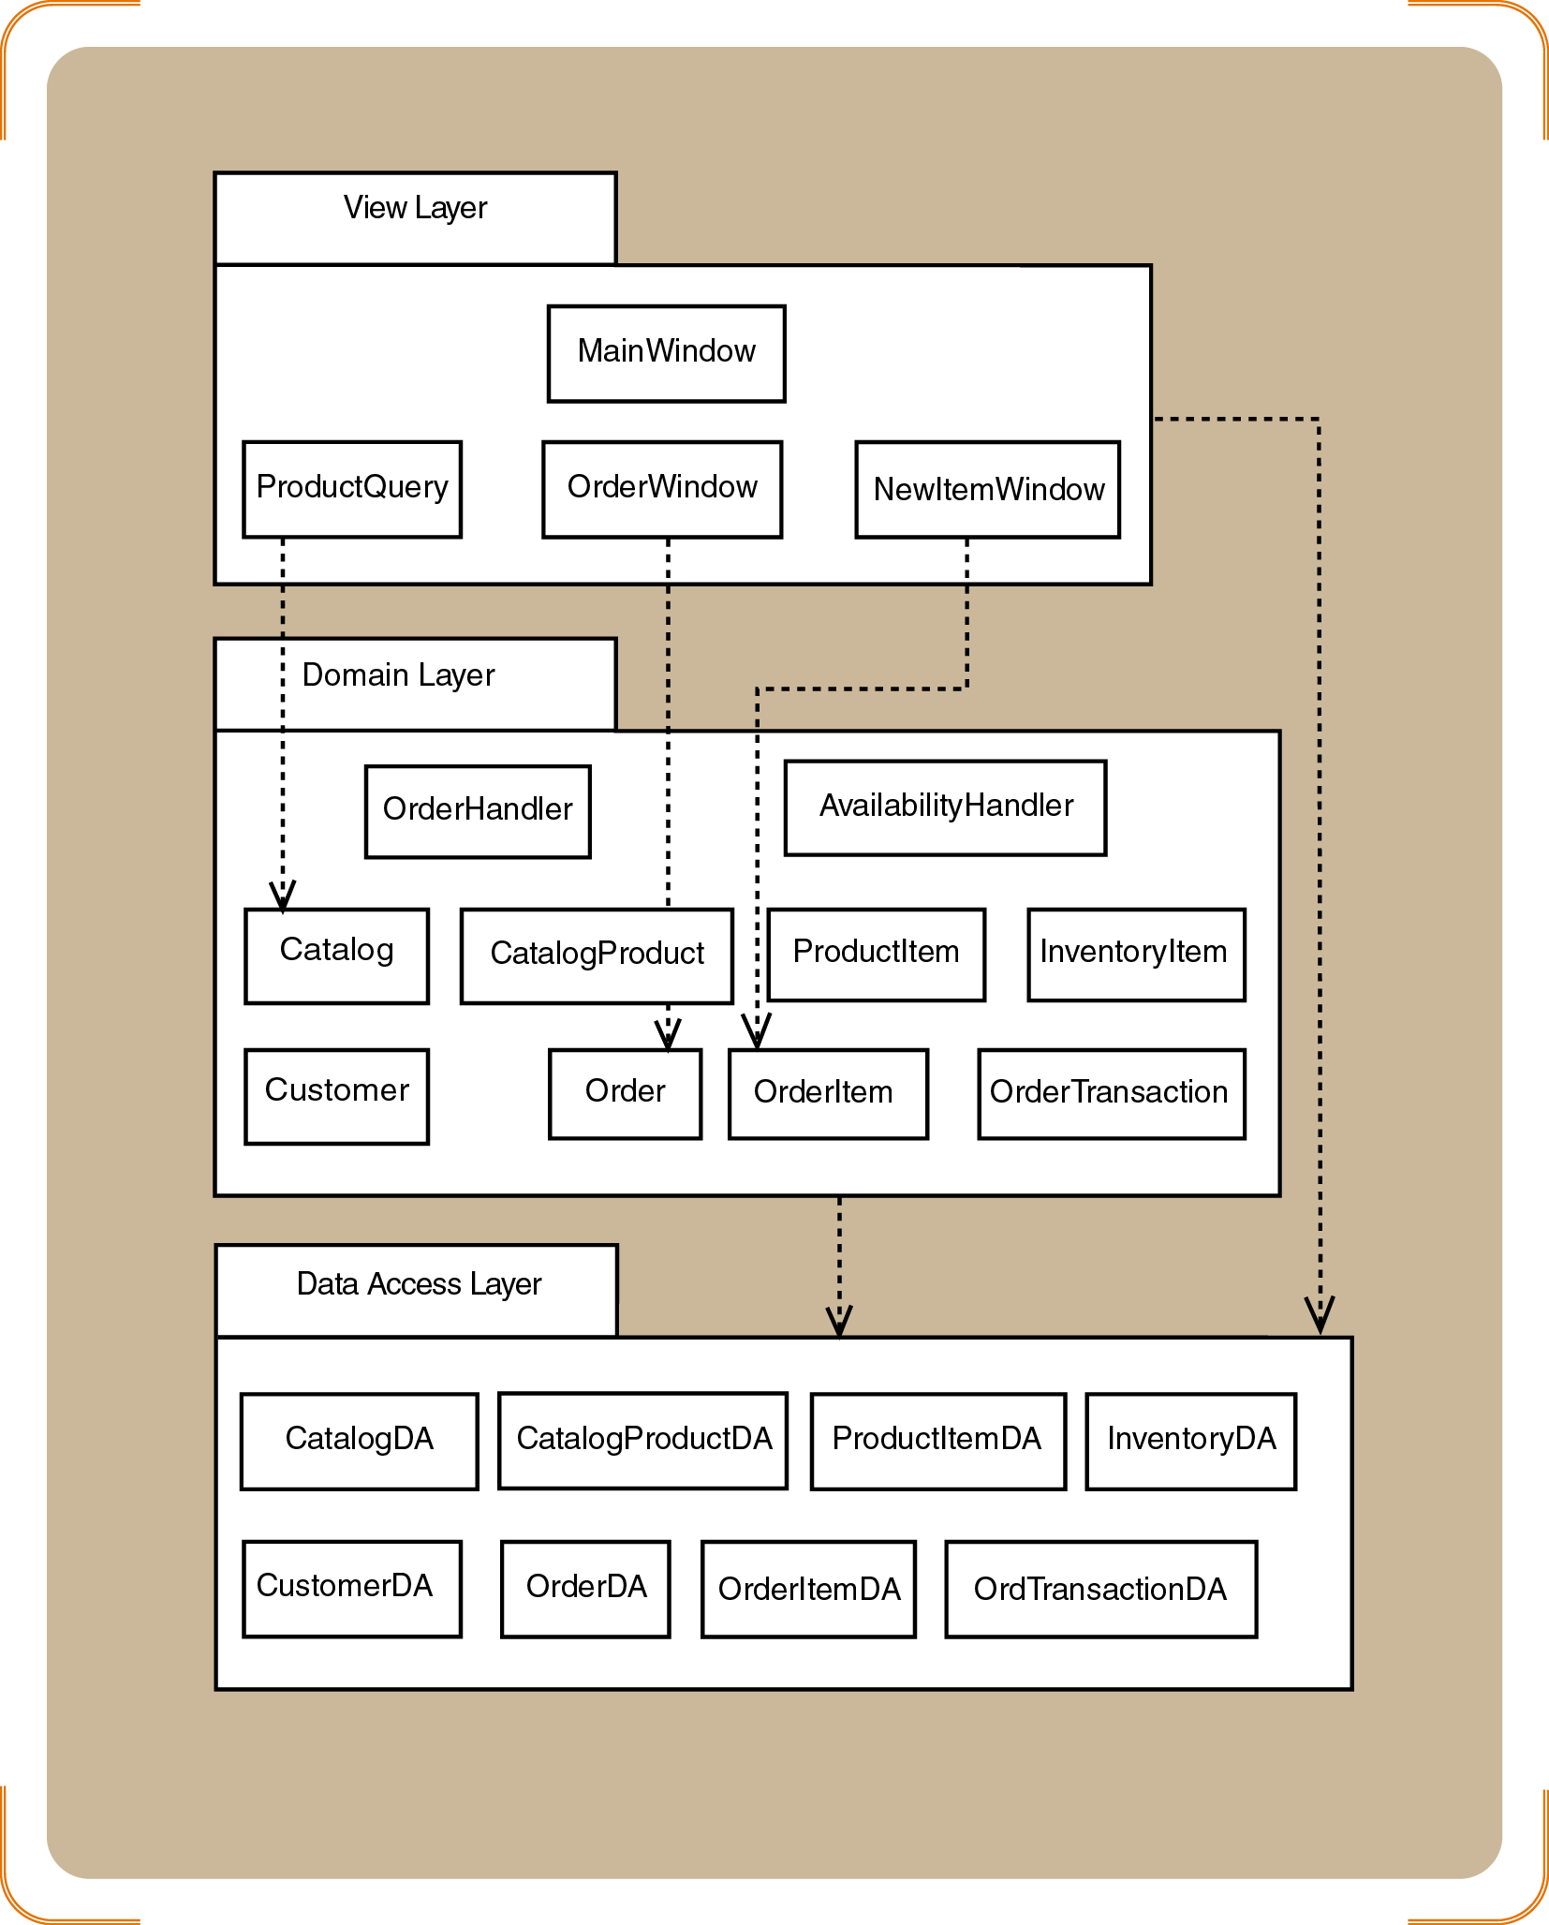
Figure 8-31
Partial design for a three-layer package diagram for RMO
Object-Oriented Analysis and Design and the Unified Process

Slide 61
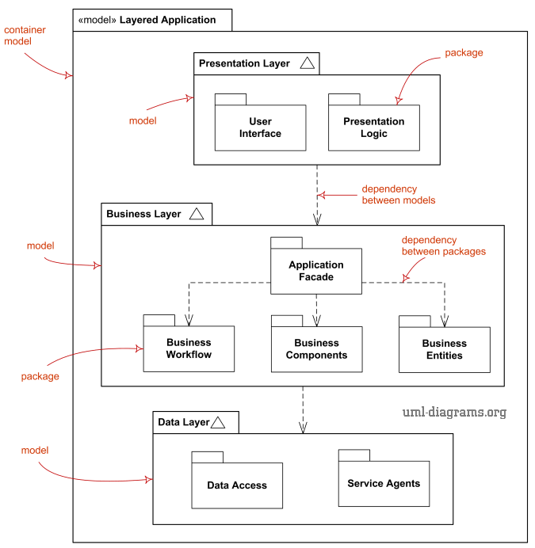
Object-Oriented Analysis and Design and the Unified Process

Slide 62
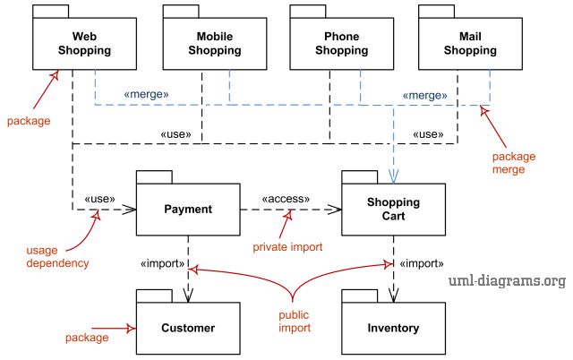
Object-Oriented Analysis and Design and the Unified Process

Slide 63
Summary
Design is driven by use cases
Two primary models developed during design
  Design class diagrams
  Sequence class diagrams
Multilayer designs partition classes into groups
  View, domain, and data access layers
Communication diagrams are a viable alternative to sequence diagrams
Object-Oriented Analysis and Design and the Unified Process

Slide 64
Summary (continued)
Object-oriented design principles
  Encapsulation
  Coupling
  Cohesion
  Navigation
  Object responsibility
Package diagrams can group classes by subsystem or layer
Object-Oriented Analysis and Design and the Unified Process

